Slide 1

Blip
Presentation by Simon Hong
Feb. 3, 2011 (and continuously updated)
This presentation contains very useful information which could save you a lot of time in the long run. It also contains some technical parts, such as DAS shared memory structure, which may be a bit too much for those trying to be just an end user. This document is not only for the users but also for myself to keep track of what’s what. Actually this is the only document that I have as well. Alas, we wish we had a hard drive in the head.

Slide 2
Is the Blip right for me? - Limitations
The default configuration of Blip may not fit everyone’s task. Because of this, the first thing you need to do is to check if it is suitable for you. There are three main limitations to Blip at this point:
With its current form, it holds all the data in the memory and writes to the hard drive at the end of the trial. Because of this reason (?, or it could have been my computer’s memory size?) Blip is able to allow only 5 minutes of maximum trial duration for 32 bit Windows. For 64 bit windows, it is about 25 minutes. If your trial runs for more than this, please try to increase the Analog Input queue size “MAX_TIMESPAN_IN_SEC_STORED_IN_Q” at “ShardConstants.h”.
Also the current form of Blip utilizes only one NI-6353 board which supports 32 analog input (AI) channels. So when you are considering the Blip, make sure that you do not need more than 32 AI channels. When counting the number of channels needed, you need to consider all of your inputs, such as, eye positions, arm positions etc., not just the neural channels. I know as a fact that it has been done to increase the available channels (at least 64 channels) by adding more NI-6353 boards. However, since I will not be using more than 4 AI channels for a while, I am not planning to expand the number of channels anytime soon. Though, you are more than welcome to increase by working on your own Blip.
  *I have tested the Blip with 32 channels (#define NUM_NN_AI_CHAN 30, #define NUM_BEHAVIOR_AI_CHANS 2) with 25 minutes of maximum per-trial memory capacity (#define MAX_TIMESPAN_IN_SEC_STORED_IN_Q 1500) without any problem on my x64 Windows 7 computer.
  3. The functions that the VIS provides are limited. Currently, the VIS can display colored boxes and pictures. That’s pretty much it. For my and my colleagues’ needs it has been great. But if you are planning to use more fancy visual effects, it is up to you. The good news is that the Blip is open source; there is no hidden magic here. You can certainly make your own functions inside the VIS or use other visual tool boxes for your own needs.

Slide 3
Read me
** Version: Blip 1.0
** For installation, see the next slide.
** Minimum required configuration:
- Windows XP32/64 bit or later version of Windows.
- Quad core or better. Recent Intel processors are a good bet for good timing measurement. Read the following from Wikipedia:
"Constant Time Stamp Counter (TSC) behavior ensures that the duration of each clock tick is uniform.... even if the processor core changes frequency.
This is the architectural behavior moving forward for all Intel processors."
** Install NI PCIe 6353 board. You also need to install NI-DAQmx software, which comes with NI PCIe 6353. Or at: http://joule.ni.com/nidu/cds/view/p/id/2604/lang/en.
If NI-DAQmx is installed without NI PCIe 6353 board, Blip will simulate the NI PCIe 6353 board, therefore your task will run as normal.
** You need to recompile DAS_sv using Visual C++ (free version of Visual C++ may work; I haven't tried; if you are using VC++2012, install the latest service pack):
Go to Menu "Project" ->"DAS_sv Properties" ->"Configuration Properties"->"C/C++"->"General".
In the "Additional Include Directories" field, add the following, if not already there:
C:\Program Files (x86)\National Instruments\Shared\ExternalCompilerSupport\C\include;..\_Include
Make sure that the National Instruments folder is in the directory. If not, change the name of the directory above to match the location.
** All the other programs (e.g. TAS, RAS, Oscilloscope etc.) do not need any further adjustment for recompiling.
**To start the program, execute "TAS.exe" in "Blip\TAS\x64\Release\“.
Other programs can be executed by clicking the icons on the MOXY (which gets triggered by TAS).
Please preserve the directory structure (e.g., TAS folder is in Blip folder), unless you decide to reprogram the codes related to the directory structure.
**Developed and freely distributed by Simon Hong.
** Legal rights and Disclaimer:
While some portion of the source code was developed in the NIH, the majority was developed outside of NIH, some dating back to early 1990s.
I hereby dedicate the work (including all the source code and documents) called "Blip"
to the public domain by waiving all of my rights to the work worldwide under copyright law,
including all related and neighboring rights, to the extent allowed by law. You can copy, modify, distribute
and perform the work, even for commercial purposes, all without asking permission.
Hopefully, this contributes to the advance of science and peace.
Use this at your own risk; I am not responsible for any occurrings due to this program.
In case you found bugs, you may report them to SimonBlip@gmail.com
**First version released in February 2011. You received free, give free.

Slide 4
How to Install
Go to: http://joule.ni.com/nidu/cds/view/p/id/2604/lang/en) and download the NI-DAQmx program using the option 1 (NI Downloader) & Install it.
Turn off the computer & install the NI-PCIe 6353 board (the power supply for this board should be separate from other power hungry instruments, such as hard disk).
Recompile Blip programs (DAS_cl, DAS_sv, ANTS …) using Visual C++ (free version of Visual C++ may work):
  Go to “Blip\DAS_sv\” and double click “DAS_sv.sln”. Go to Menu ->"Project" ->"DAS_sv Properties" ->"Configuration Properties"->"C/C++"->"General".
  In the "Additional Include Directories" field, verify the following:
    C:\Program Files (x86)\National Instruments\Shared\ExternalCompilerSupport\C\include;..\Include
  It has two parts: first part, for the NI 6353 device; second part, the Blip directory “..\_Include” separated by a semicolon. Make sure that the National Instruments folder is in the directory designated by the first part. If not, change the name of the directory to match the location.
  All the other programs (e.g. TAS, RAS, Oscilloscope etc.) do not need any further adjustment for recompiling.
  After installing, click TAS.exe in “x64/Release/” directory (x64 bit case). Click the first icon (spike discriminator) in MOXY. Now, if you see some lines running in MOXY, you have succeed in installing.
  DAS_sv detects the PCIe/USB-6353 device automatically. If there are more than one device, DAS_sv will display the situation and use the first device. If you want to change this behavior, go to DAS_View.cpp and reconfigure.
  Maintenance
  It is advised to keep your own codes separate from the codes provided. In most cases, TAS is the only one that you need to work with. Use the TASView as your main class to expand. Most of the utility part of TAS is in “Update_Me_TAS_Doc” .cpp & .h files. So try not to mass with these Doc files.
  When a new version of Blip is released, it comes with “Update_existing_Blip.exe” file. If you already have your Blip, just run this to update your Blip. Running this program will replace (1) TAS\Update_Me_Doc.cpp, TAS\Update_Me_Doc.h and the whole TAS\Update_Me folder. (2) ANTS, CLAS, DAS_cl, DAS_sv, MOXY, Oscilloscope, RAS, TAS, VIS, XCOR, _Include (except “End_Users_Definitions.h”), _Utilities folders & Blip_Guide.ppt. This will not touch other files and folders.

Slide 5

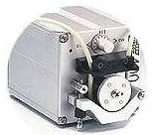
Blip
VIS
subject’s monitor
(Stimulius generator)
TAS
Utilities:
1) DAS client (Spike Sorter)
2) Oscilloscope
3) Raster Plotter
4) Antidromic Stimulator
5) MOXY,
…
Task scheduler
Your tasks here!
DAS server
1) Data acquision
2) Spike sorter
Computer
NI USB/PCIe-6353
Warning: USB version 6353 is not as time accurate as the PCIe version. USB version is useful only to “simulate” the recording situation. When it comes to something critical, such as antidromic stimulations, please use the PCIe version.
4 Eye analog
Analog
Digital Output
Digital Output
Eye coil
Amp / Filter
Stimulator
Relay
Projector
Juice
Notes:
5

Slide 6
REX/MEX/VEX vs. Blip
 | REX/MEX/VEX | Blip
# of computers | 3 (delay & jitter of spike timing occur due to inter-computer communication) | 1 (minimum quad core)
# of PCI boards | 3+? | 1
Operating system | QNX | Widows XP & later versions (32bit / 64bit)
Tools | Many | A few
Support | Technicians (dedicated) | Simon (busy doing other things - but his is nice)
Language | Special script language | C/C++ (Visual C++ 2012)
# of neural channels | 2 +? | 32+
Reliability | Tested | Being tested since the beginning of 2011
Ease of use | ? | You be the judge
Data logging method | Reports the earliest time available after an event. | Reports the time when it really happened, by examining data back in time.
Real time | Yes (maybe) | Almost
What do you mean by almost?

Slide 7
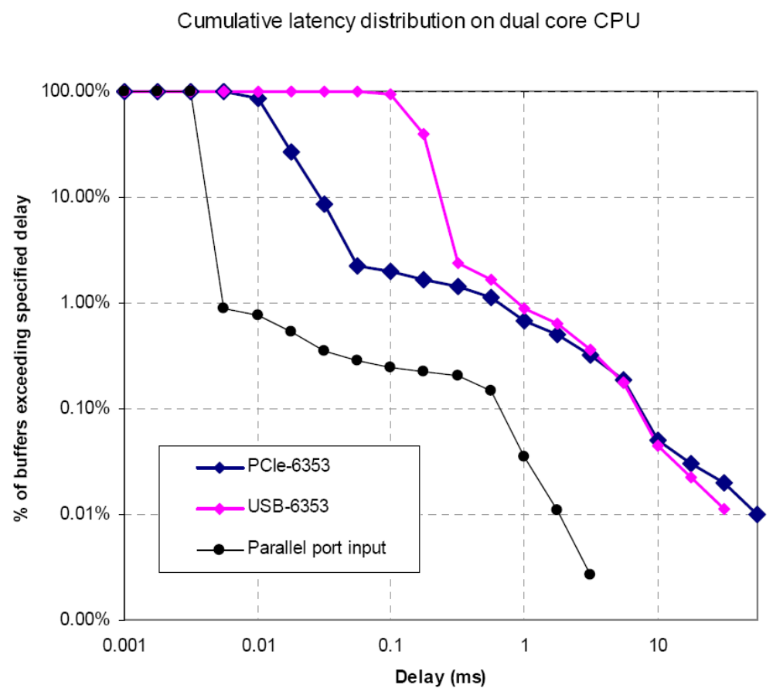
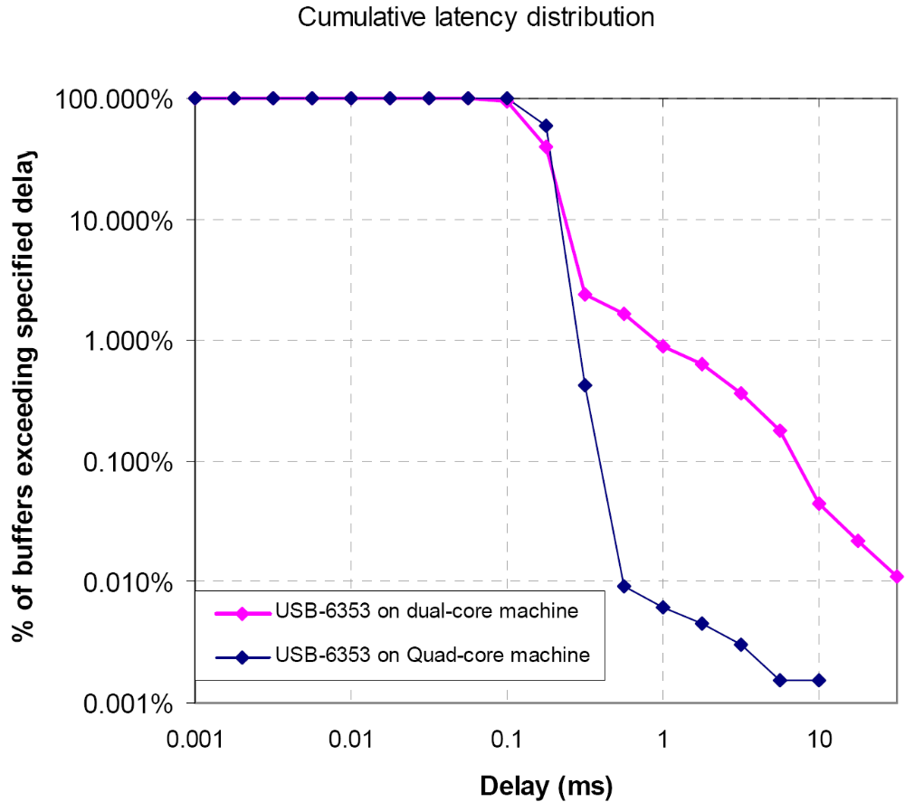
Windows, real time (here defined as: “jitter” <1ms) ?
on quad core CPU
Tom:
Long buffer delays (exceeding 1 ms) are much rarer on quad-core than
dual-core machine. This is evidenced by the large downward shift of the blue trace
relative to the pink trace.

Slide 8
Conclusion of windows’ capability of being a real time machine
It is NOT a real-time machine.
BUT, with some cleaver tweaks, it can be real-time most of the time.
  (It uses a high-performance clock instead of those commonly used timing functions, such as “GetTickCount()”)
Occasional jitter of timing (< 0.01%) doesn’t seem to affect the overall results that we acquire. (Did I mention the jitter in the REX/MEX system?)
Almost-Real-Time

Slide 9
What are the components of Blip? First, the NI-6353
VIS
subject’s monitor
(Stimulius generator)
TAS
Utilities:
1) DAS client (Spike Sorter)
2) Oscilloscope
3) Raster Plotter
4) Antidromic Stimulator
5) MOXY …
Task scheduler
DAS server
1) Data acquision
2) Spike sorter
Computer
NI USB/PCIe-6353
4 Eye analog
Analog
Digital Output
Digital Output
Eye coil
Amp / Filter
Stimulator
Relay
Projector
Juice

Slide 10
Specifications of NI-6353
Specifications Summary
Analog Input
Channels | 32 (single ended) or 16 (referenced)
Single-Ended Channels | 32
Differential Channels (signal-reference) | 16 (two analog channels are used to decide the signal of the source; one of them is the reference)
Resolution | 16 bits
Sample Rate | 1.25 MS/s
Throughput | 1 MS/s
Number of Ranges | 7
Simultaneous Sampling | No
Analog Output
Channels | 4
Resolution | 16 bits
Update Rate | 2.86 MS/s
Digital I/O
Bidirectional Channels | 48
Input-Only Channels | 0
Output-Only Channels | 0
Number of Channels | 48 , 0 , 0
Timing | Hardware , Software
Clocked Lines | 32
Max Clock Rate | 10 MHz
Logic Levels | TTL
Input Current Flow | Sinking , Sourcing
Output Current Flow | Sinking , Sourcing
Programmable Input Filters | Yes
Counter/Timers
Counters | 4
Buffered Operations | Yes
Debouncing/Glitch Removal | Yes
GPS Synchronization | No
Maximum Range | 0 V , 5 V
Max Source Frequency | 100 MHz
Minimum Input Pulse Width | 10 ns
Pulse Generation | Yes
Resolution | 32 bits
Timebase Stability | 50 ppm
Logic Levels | TTL
Timing/Triggering/Synchronization
Triggering | Analog , Digital
Synchronization Bus (RTSI) | No
Supports Programmable Power-Up States? | Yes
Current Drive Single | 24 mA
Current Drive All | 1 A
Watchdog Timer | Yes
Supports Handshaking I/O? | No
Supports Pattern I/O? | Yes
Maximum Input Range | 0 V , 5 V
Maximum Output Range | 0 V , 5 V
One NI PCIe 6353 provides 32 analog channels (single ended channels): one cable provides 16 analog channels.
So, to use the full capacity, 2 cables are needed for one NI PCIe board.

Slide 11
Summary: specification of “NI-6353”
Specifications Summary
32 analog inputs, 1.25 MS/s 1-channel, 1 MS/s multichannel; 16-bit resolution, ±10 V
Four analog outputs, 2.86 MS/s, 16-bit resolution, ±10 V
48 digital I/O lines (32 hardware-timed up to 10 MHz)
Four 32-bit counter/timers for PWM (pulse width modulator), encoder, frequency, event counting, and more
Advanced timing and triggering with NI-STC3 timing and synchronization technology
Support for Windows 7/Vista/XP/2000
Coil could kick back. So use relay or put a diode if you are to control a coil.
*Only one software program exclusively controls the NI 6353.

Slide 12
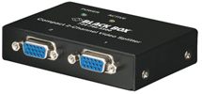
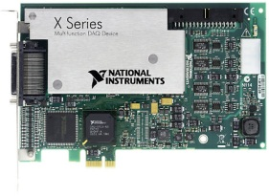
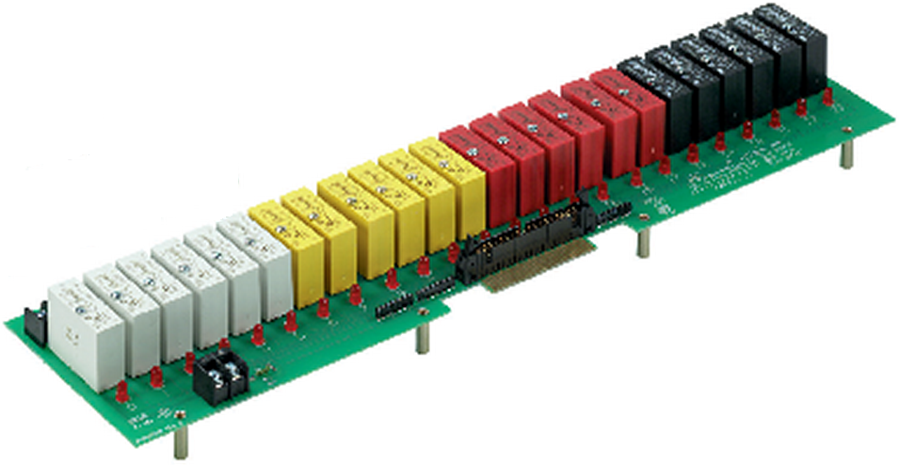
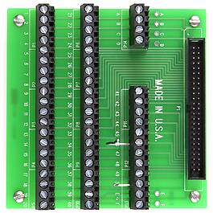
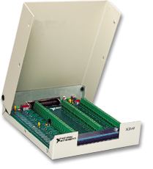
Wiring of Simon’s system (at NIH)
Computer
VGA Video Splitter, 2-Channel,
by Black Box
Team-Solutions.com
CIO-Mini50 (50 Pin Universal Screw Terminal)
Grayhill 24 Channel Rack (70RCK24)
NI PCIe-6353
http://sine.ni.com/nips/cds/view/p/lang/en/nid/207410
NI SCB-68
Digital Output
Eye coil
Amp / Filter
Stimulator
Beep
Speaker (44)
Tone Speaker (46)
Isolator
Projector
Juice dispenser
Juice

Slide 13
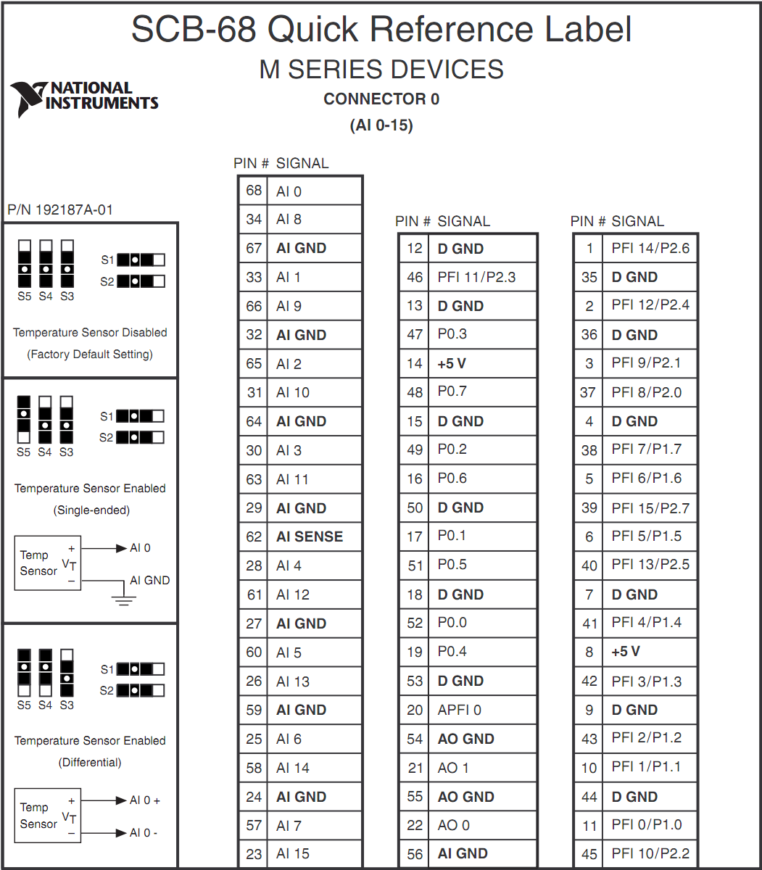
NI SCB-68 (connector block) Pinout & an example of connections
Neuroal signal 1
Neuroal signal 2
Team-Solutions.com
CIO-Mini50 (50 Pin Universal Screw Terminal)
Relay 0: Juice
Eye horizontal
Relay 1: Correct tone
Relay 2: Wrong beep
Eye vertidal
3 gating signals
Stimulator
* While the SCP-68 pinout label above is for the M series, it also applies to the X series which includes the PCIe/USB-6353.

Slide 14
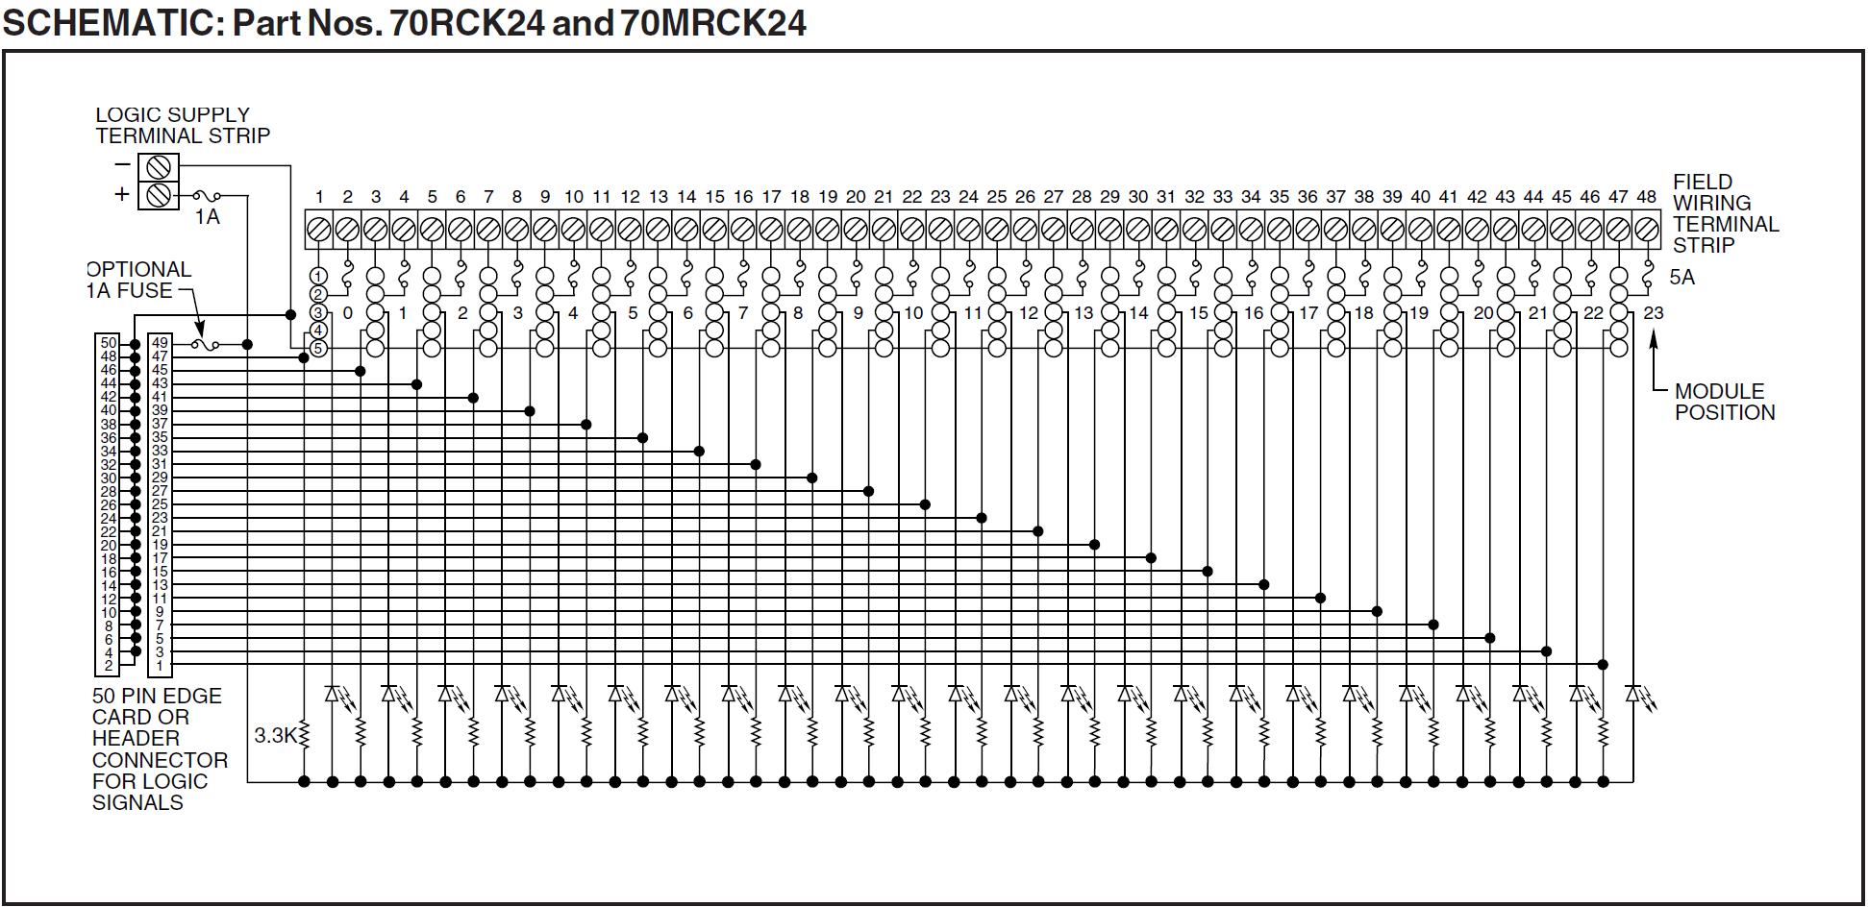
Relay Circuit: NI input acts as a voltage sink to trigger the relay
5V from NI PCIe-6353
5V
NI

Slide 15
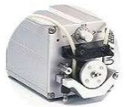
DAS (Data Acquisition System)
DAS Server
Invisible, to minimize the effect of display delay.
Handles all data (input & output) at 2kHz sampling rate. (NI sampling rate is 40KHz)
Detects threshold-crossing waveforms.
Decides whether or not the waveform meets the criteria, set by the VT-boxes visible in DAS_cl window.
Generates lists of data according to the spike sorting.
DAS Client
Accepts user commends, such as, change of threshold, VT-box setting; enables/disables channels.
Sends the information to DAS Server.
Displays waveforms, sorted by the server.
Saves the waveforms according to user’s commend.
VIS
subject’s monitor
(Stimulius generator)
TAS
Utilities:
1) DAS client (Spike Sorter)
2) Oscilloscope
3) Raster Plotter (RAS)
4) ANTS, (5) MOXY
…
Task scheduler
DAS server
1) Data acquisition
2) Spike sorter
Computer
NI USB/PCIe-6353
4 Eye analog
Analog
Digital Output
Digital Output
Eye coil
Amp / Filter
Stimulator
Relay
Projector
Juice

Slide 16
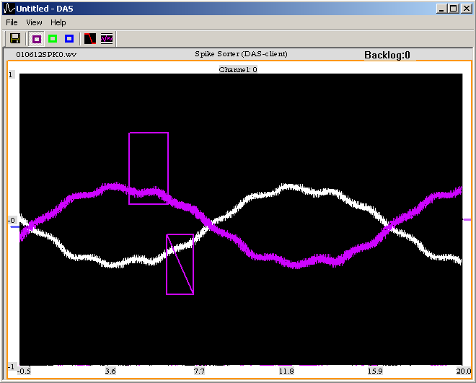
DAS Client
This one decides whether the signal needs to cross from bottom up or top to bottom of the threshold.
Click this to change the channel that you would like to monitor
Scale auto-adjust to fit the amplitude of the signal.
Up to 3 different color-coded neuronal signals can be discriminated at a time
Click this to get an alert when the Blip experiences problem of getting data on time (i.e. jitter in data sampling)
You can recall the size and position of the current window later: File→Remember_Window_Position
Click this to save the waveforms to a file. (Currently, only the waveforms from one channel are allowed to be saved at a time.)
R
Click this to set the prefix and suffix of the file to save the waveforms.
Voltage-Time discriminator (VT) box: Click and drag an empty space to make one. Right click to remove.
Threshold bar: move this to change the threshold of the signal
Rejection VT box: Click and drag an empty space in combination with any key press to make one.
Click this to change the scales of the axes.
Gain control

Slide 17
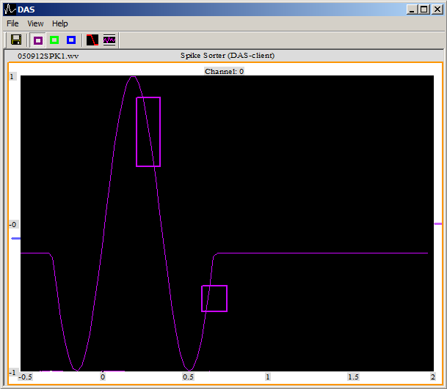
Voltage-Time Discriminator (VTD)- inside
To determine whether or not a waveform is selected,
the DAS needs at least the number of data points defined by the time interval between the “threshold-crossing” and the farthest edge of the last V-T box (the red bar, see the figure below). This is given by a variable (*M_MiniRequiredLengthOfwaveForExamination).
Because of this, the DAS can work on the VTD process for “DistToSearchForThresholdXing” number of data points determined as follows:
, where m_ThresholdXingSearchIdx is the “current working index” of the VTD process, and usableAiIdx is the latest AI index that is usable.
DistToSearchForThresholdXing = usableAiIdx - m_ThresholdXingSearchIdx- *M_MiniRequiredLengthOfwaveForExamination
* Because of this construction, any signal, crossing the threshold, can be safely examined by the VTD process and declared as selected or not selected, as done in the function CAiChannel::Register_n_Classify_wavelet().
threshold-crossing
farthest edge of the last V-T box
*M_MiniRequiredLengthOfwaveForExamination
m_ThresholdXingSearchIdxi
m_SizeOfDataQueue-1
DistToSearchForThresholdXing
usableAiIdx
double M_AI[ ]
DistToSearchForThresholdXing = usableAiIdx - m_ThresholdXingSearchIdx- *M_MiniRequiredLengthOfwaveForExamination

Slide 18
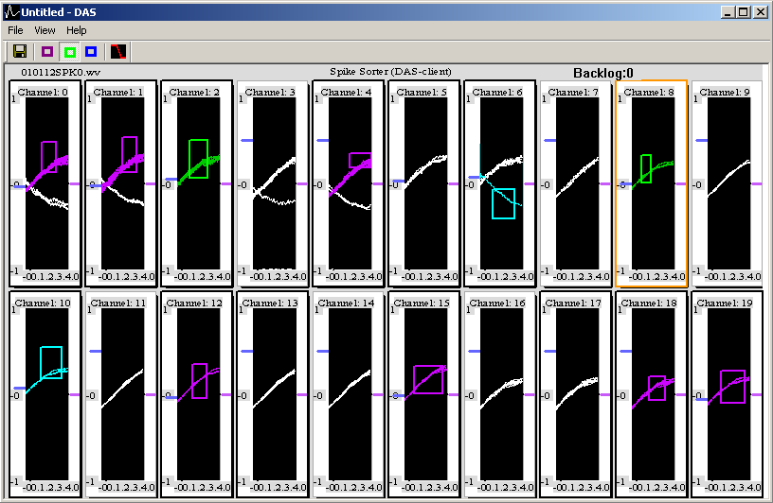
How many Analog Input (AI) channels can we have?
Short answer: Currently Blip supports only one NI board, so you can have up to 32 AI channels.
It is possible that you can have more NI board to have more channels. This will require some reprograming of DAS.
The following shows an example screen shot of DAS client (DAS server runs only background) sampling 20 independent channels. NI-6353 board somehow carries over the signal of one channel to the next channel in case the next channels is not connected to anything. So the following figure shows duplicate signals appearing in different channels even though only the first channel is getting the input. If you do not want to see such behavior, short circuit the next channel to the one getting the real signal. It is especially important when you do not use one of the channels. For example, you use channel 0 for the neural recording and “reserve” the channel 1 for a possible second neural channel; and you decide to use the channel 2 & 3 to monitor one of the eyes. In this scenario, the channel 2 may get contaminated with the carried over signal from the unconnected channel 1. To prevent this, short circuit (connect the channel input to the ground) the channel 1.
To create a new configuration with a different number of channels (similar rules apply to most of the other programs):
Delete all the figures: Right click and select the “delete” option for all the existing channel figures.
After closing all figures, it will bring up all the available channel figures for you to reconfigure. After setting the figure confiuration, save this setting: File->Save_Config.
In the example above, 20 channels are active. DAS displays only the channels that are available: by default 2 channels; so you will see only 2 channels when you delete all the figures. To change this setting see the next slide.

Slide 19
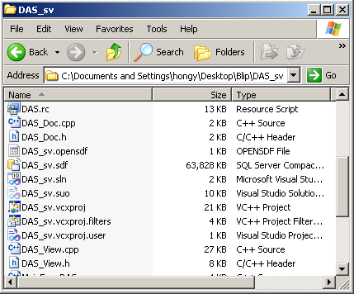
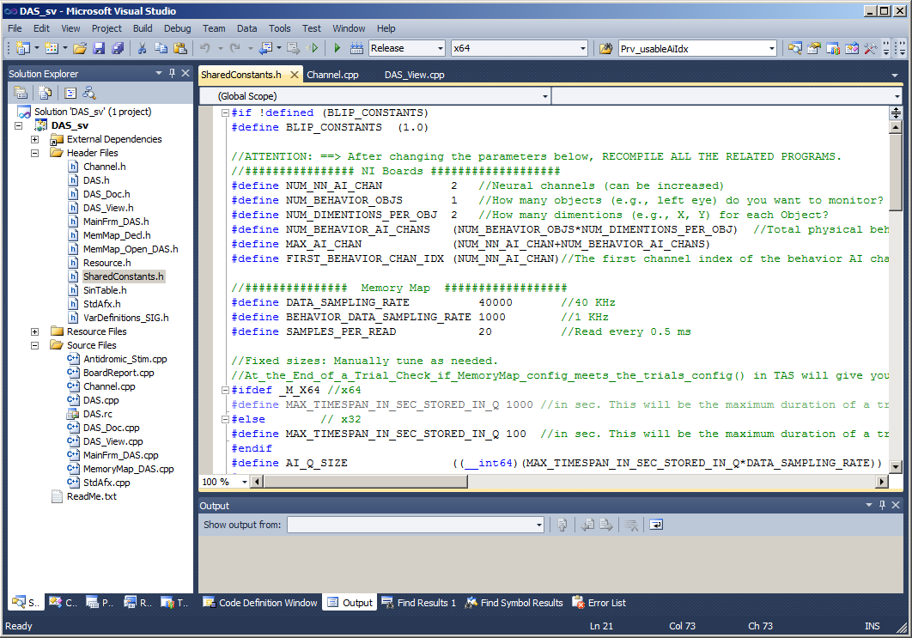
To change the number of channels that DAS supports…
Open DAS_sv solution:
2) Open “SharedConstants.h”
3) Change “NUM_NN_AI_CHAN” value
to a new value that you want.
3) Recompile all the related programs that share the Memory Map ( DAS_sv, DAS_cl, RAS, TAS, MOXY, Oscilloscope, CLAS, ANTS, VIS)

Slide 20
End_Users_Definitions.h
As an end user, you need to define how many Analog Input Channels you want and how they should be used (neural signal channels, 2D behavior channels, other analog channels) using the parameters in “End_Users_Definitions.h”, which is in “_Include” folder. See an example below.
//########### Dear End Users, Define your channel configurations in the following ####################
//########### After changing the parameters below, RECOMPILE ALL THE RELATED PROGRAMS.
//How many analog input neural channels do you want?
#define NUM_NN_AI_CHAN 2
//How many analog input 2D behavioral objects (e.g. 2 eyes with x, y channels each) do you want to monitor?
//One object occupties 2 analog channels. Blip can monitor these objects and plot in the X-Y coordinate in realtime in MOXY.
#define NUM_2D_BEHAVIOR_OBJS 2
//How many OTHER AI channels do you want? (e.g., photo diode, actuator positions...)
//Any voltage inputs can be monitored with this.
#define NUM_OTHER_AI_CH 6
The total number of analog channels is calculated as follows:
  Total # of analog channels = NUM_NN_AI_CHAN + (NUM_2D_BEHAVIOR_OBJS x 2) + NUM_OTHER_AI_CH
  = 2 + (2 x 2) +6 (according to the example above)
Further customization, such as sampling rate and retrieval frequency, may be made by changing “SharedConstants.h” explained in the next page.
It is a good idea to make a note of your configuration: WHAT ARE CONNECTED TO WHICH CHANNELS!!

Slide 21
Organization of Analog Input channels of DAS - an example
The flowing diagram shows an example of Analog Channel parameters. An equivalent data structure for the shared memory map is shown in the figure below.
In case you use 2D objects, such as the eye, the TAS supports a various position measuring functions.
Currently, the OTHER channel is used to measure the onset of the display by VIS and TAS.
Often times, signals of a channel “roll-over” to the next channels. So if you see some noise caused by some previous AI channel (e.g., noise at channel 2 coming from channel 0), you can ground the next channel of the noise-source channel (e.g., ground channel 1) to remove the roll-over noise.
double M_AI[0]
double M_AI[1]
In: “End_Users_Definitions.h”
//Neural channels (can be increased)
#define NUM_NN_AI_CHAN 2
//How many 2D objects (e.g., left eye, right eye) do you want to monitor?
#define NUM_2D_BEHAVIOR_OBJS 2
//How many OTHER AI channels?
#define NUM_OTHER_AI_CH 1
In: “SharedConstants.h”
//Total number of Behavior AI channels (The data in these channels will be recorded and saved by TAS)
#define NUM_2D_BHVR_AI_CHANS (NUM_BEHAVIOR_OBJS*2)
//Total physical AI channels.
#define MAX_AI_CHAN (NUM_NN_AI_CHAN + NUM_2D_BHVR_AI_CHANS+ NUM_OTHER_AI_CH)
//The first channel index of the behavior AI channel is the next channel of the last neural channel.
#define FIRST_2D_BHVR_CH_IDX (NUM_NN_AI_CHAN)
//The first channel index of the OTHER AI channel is the next channel of the last 2D behavioral channel.
#define FIRST_OTHER_CH_DIX (NUM_NN_AI_CHAN+NUM_2D_BHVR_AI_CHANS)
double M_AI[2]
Object 1
double M_AI[3]
Object 2
double M_AI[4]
double M_AI[5]
double M_AI[6]

Slide 22
Where are my AI channels in the connector box?
Blip follows the rule:
  Neural AI channels (e.g., you have 2 neural channels):
    First neural channel: AI 0
    Second neural channel: AI 1
  2D Behavioral channels (e.g., you have 2 2D behavioral channels: x1, y1, x2, y2):
    x1: AI 2
    y1: AI 3
    x2: AI 4
    y2: AI 5
    Other behavioral channels (e.g., you have 3 other channels: other1, other2, other3):
      other1: AI 6
      other2: AI 7
      other3: AI 8

Slide 23
Summary: “how to change the number of AI channels that DAS supports”
Change “NUM_NN_AI_CHAN” value to a new value that you want.
  *NOTE: Because every channel has its own data storage queue, 32 bit version may have trouble creating Memory Map (shared memory space) if you set both the number of channels (NUM_NN_AI_CHAN) and the size of the data storage queue (MAX_TIMESPAN_IN_SEC_STORED_IN_Q) BIG at the same time; in this case the program will display a warning. MAX_TIMESPAN_IN_SEC_STORED_IN_Q controls the size of the data storage in queue in second (currently set to 300 sec for x32; check the value yourself, it may be set different). Therefore, a trial longer than the size of this will not be able to properly store all the data. So if your DAS has trouble creating the Memory Map, try to find a compromise between these two numbers.
  *NOTE: The total number of Analog Input channels that you are trying to use is a sum of the neural AI channels & the behavioral AI channels. This number (#define MAX_AI_CHAN (NUM_NN_AI_CHAN + NUM_BEHAVIOR_AI_CHANS) ) should NOT exceed the total AI channels available, which is 32 (one NI board). If it does, Blip will give you a warning.
Recompile (F7 in VC++) all the programs in Blip solution (DAS_sv, DAS_cl, RAS, TAS, ….). Make sure that you are in 64 bit mode and release mode for compiling.
Change the DAS_cl configuration to see the channels you want. And save the new configuration to a file (e.g. Config_DAS_cl.txt or Config_DAS_cl2x10.txt)
*NOTE: Since NI-6353 runs to acquire data from all the open channels, even when you don’t use them all, it is a good practice to minimize the number of channels open just to meet your current needs. Also Blip creates the Memory Map space for each channel, which you may not use, AND records all the open behavioral AI channel (specified by NUM_BEHAVIOR_AI_CHANS) data. Flexibly changing the number of channels at user’s demand to optimize the performance can be done. But since several programs share the Memory Map, it is a though call, and may take a lot of coding.

Slide 24
Organization of Digital Input / Output channels of NI-SCB68
NI SCB-68
NI SCB-68
First SCB-68 Box:
Pin Out | Actual Line number
P0.0~0.7 | 0~7
P1.0~1.7 | 32~39
P2.0~2.7 | 40~47
Second SCB-68 Box:
Pin Out | Actual Line number
P0.0~0.7 | 8~15
P1.0~1.7 | 16~23
P2.0~2.7 | 24~31

Slide 25
Digital Output channels - an example
An example of parameters of Digital I/O is shown below.
In this example, the user assigns 24 channels as Digital OUT (channel 0 being reward, channel 8~16 being gating relays, etc.)
“SharedConstants.h”
//ATTENTION: ==> After changing the parameters below, RECOMPILE ALL THE RELATED PROGRAMS.
//################# Digital OUTPUT (change this to meet your needs) ####################
#define MAX_DO_NUM 24 //==> NOTE! this is the maximum number allowed! Change this number if you want.
//Make sure that "DAQmxCreateDOChan()" in the "Digital Output Registration" in DAS_sv_main() reflects this.
//################# Digital OUTPUT for Stimulation ####################
// Dear User:
// If you use more than (DO_STIM_TRIGGER_CHAN) number of the digital output function, you may want to modify the following "Gating channels" definitions to
// accommodate your needs.
// You can shift the channels to other channels and also reduce the number of gating channels.
// However, (DO_STIM_TRIGGER_CHAN, MAX_NUM_STIM_CHANNELS, DO_FIRST_GATING_CHAN, DO_LAST_GATING_CHAN) definitions below
// must be defined since Blip has functions that require them.
//Stimulation and Gating channels
#define DO_STIM_TRIGGER_CHAN 8 //The channel that gets the TRIGGER signal for the stimulator.
#define MAX_NUM_STIM_CHANNELS 20 //The actual number of stimulating channels will be limited by the number of gating channels given below.
#define DO_GATING_CHAN1 9 //Gating relay
#define DO_GATING_CHAN2 10 //Gating relay
#define DO_GATING_CHAN3 11 //Gating relay
#define DO_GATING_CHAN4 12 //Gating relay
#define DO_GATING_CHAN5 13 //Gating relay
#define DO_GATING_CHAN6 14 //Gating relay
#define DO_GATING_CHAN7 15 //Gating relay
#define DO_GATING_CHAN8 16 //Gating relay
#define DO_FIRST_GATING_CHAN DO_GATING_CHAN1 //Put the first gating channel here.
#define DO_LAST_GATING_CHAN DO_GATING_CHAN8 //Put the last gating channel here.
*When you use the “Blip_Updater.exe” to update your exsiting Blip to a new Blip, “SharedContants.h” will be overwritten and your previous “SharedConstants.h” will be renamed as “Previous_SharedConstants.h”. So, if you had customized “SharedConstants.h”, you need to adjust the values for your needs.

Slide 26
Digital Input channels - an example
An example of parameters of Digital Input is shown below.
In this example, the user assigns 24 channels as Digital IN.
“SharedConstants.h”
//################# Digital INPUT (change this to meet your needs) ####################
#define MAX_DI_NUM 24 //==> NOTE! this is the maximum number allowed! Change this number if you want.
//Make sure that "DAQmxCreateDIChan()" in the "Digital Input Registration" in DAS_sv_main() reflects this
Digital Input signals are stored in M_DI_Array[ ] variable in 2kHz.
To access the digital input values, use m_pDoc->M_DI_Array[ ] in TAS.
*When you use the “Blip_Updater.exe” to update your exsiting Blip to a new Blip, “SharedContants.h” will be overwritten and your previous “SharedConstants.h” will be renamed as “Previous_SharedConstants.h”. So, if you had customized “SharedConstants.h”, you need to adjust the values for your needs.

Slide 27
Digital Communication
The following two steps in TAS will set Digital Outputs.
    1) Set digital bits:
    Use "m_pDoc->M_DO_Array[Digital Output channel # here] = 1 or 0;"
    2) Send Digital Output:
    Use "m_pDoc-> SendOut_M_DO_Array();”
You can connect the corresponding digital channels to the target machine to communicate.

Slide 28

TAS (TAsk Scheduler)
Sets the schedule of the trial.
Communicates with VIS to display visual stimuli, and with MOXY to show the progress of the task.
Has icons for task related functions (e.g., save icon, play & pause…)
Fetches the spike & behavioral data from the shared memory, and creates shared (mostly with RAS) memory related to each trial.
Upon user’s request, the trial data can be saved to a file. In the case the user tries to overwrite an existing .rst file, TAS rescues the existing one by changing the extension to .bak. So, if not needed, delete the .bak files manually.
This is the program that you use to insert your tasks. You write your own codes and make icons and dialogs etc. In the following slides you will see the examples of how to do it.
Save the trial data to a file.
Start the task
Pause the task
Your creation here. The example shows icons that will bring up dialogs.

Slide 29
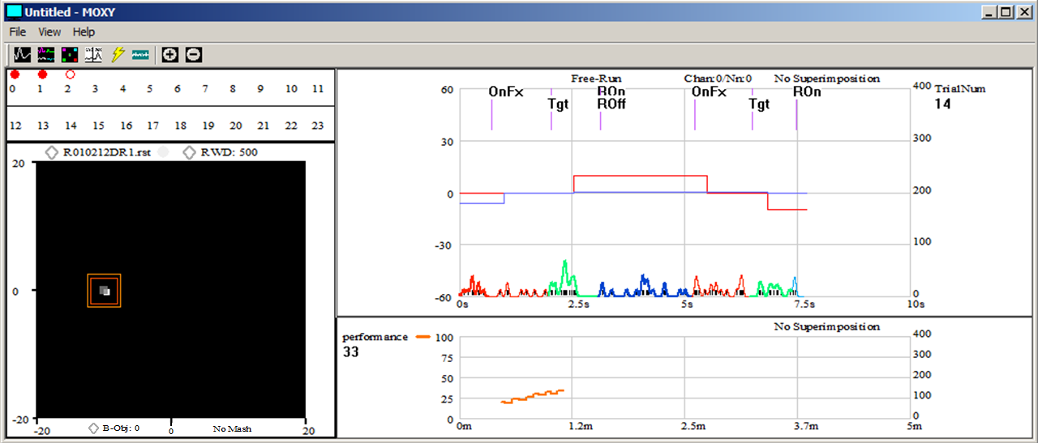
MOXY (Monitoring System)
Rescale the eye position monitor
Launch Oscilloscope
Click to toggle between superimposition
& no superimposition
Launch ANTS
Click to set an ECode to “trigger” the figure.
Launch RAS
Launch VIS
Click to change the scales of axes.
Launch CLAS
Channel & neuron ID to monitor
User picked variable
ECodes
Launch DAS server & client
Clickable DIO switches
Click this to increase or decrease the ID of the neuron to be saved (e.g., 1).
Click to set the prefix & suffix of the file to be saved
Click to change the reward amount
Eye position monitor, clickable.
User picked variable to monitor
Running SDF
Behavioral object (e.g., 0, the first object: left eye) to monitor. The maximum number of this is determined by NUM_BEHAVIOR_OBJS
Eye position trace
Adjustable horizontal separator
Able/disable mash
Adjustable vertical separator

Slide 30
MOXY (Monitoring System)
MOXY Communicates with TAS to display the status of various parameters.
Has icons of other utilities (VIS, RAS, DAS etc.) to launch.
Provides integrated monitoring system, including, the eye position monitor, digital I/O status, continuous spike density function (SDF), spike raster, Ecodes, and all the user-picked variables.
Useful user inputs:
    Control + left mouse click on the black eye screen sets a bias for the eye to be at that point; Control + Horizontal arrows decrease (←) or increase (→) eye gain; Control + Vertical arrows decrease (↓) or increase (↑) eye gain. The gain and bias will be automatically stored.
    When you click any of the DIO panel, MOXY will generate an event which will be saved by TAS. For example, if you click “0” on the DIO panel, a user-defined variable “User-clicked DO: 0” will be registered and will be saved by the TAS at the end of the trial.
    Right mouse click on the black eye screen presents a square stimulus. It will generate a user-defined variable “User-presented a dot: x , y” will be registered and will be saved by the TAS at the end of the trial. x, y are the coordinates in degrees of the dot on the monitor. If you want to show a photo instead of a square at the right click, go to VIEW menu → Click “Right_Click_Shows_Figure” & register the file name of the figure in your TAS task.
    You can left-mouse-click the eye position monitor to simulate the position of the eye. It may be helpful during your task programming and debugging.
    “Tab” key activates DO 0 (e.g. gives juice), a user-defined variable will be generated.
    *User input generated user-defined variables may be useful when you try to do a “clinical test” on the subject: the signal detected by the DAS can be correlated with the stimuli that you have presented.

Slide 31
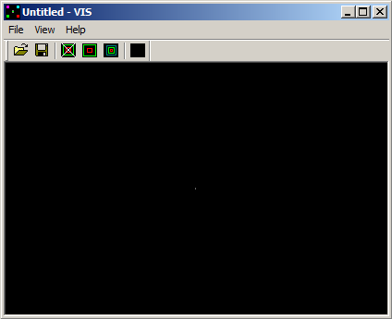
VIS (VIsual Stimulus displayer)
Bigger Scale (Zoomed-out)
Smaller Scale (Zoomed-in)
Display the calibration
Clear screen
Save the current configuration.
Especially, after calibration of the screen.
Open a configuration file

Slide 32
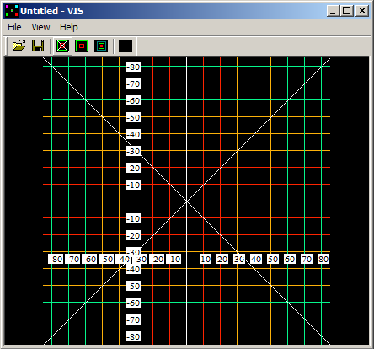
Calibrate the screen with VIS
Before you use VIS, you need to calibrate the screen:
Open VIS and maximize it to fit the screen.
Press the “calibration” icon. This will show lines crisscrossing the window and corresponding numbers in degrees.
Use the “Bigger Scale” and “Smaller Scale” icons to adjust the angle. (You need to triangulate using the distance between the screen and the eye)
Save the setting to a configuration file by clicking the save icon and choosing “Blip\_Config_Files\Config_VIS.txt”.
*After this, VIS will use the saved setting when it starts.

Slide 33
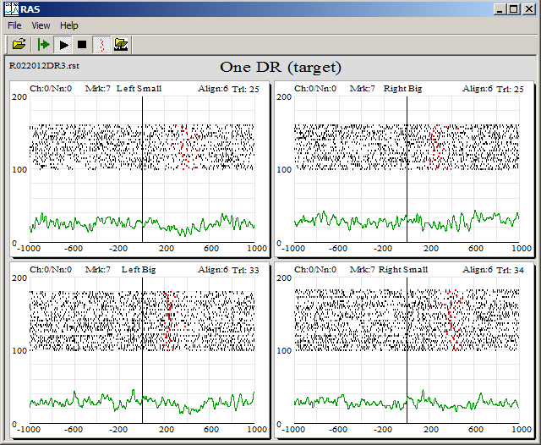
RAS (RASter plotter)
Display previously stored “.rst” file
Show/hide the event mark
Click the label to 1) change the name of the whole figures.
Stop/Pause
Click one of these to set the alignment ECode.
Start
Start afresh
Open a configuration file
The configuration file loaded.
Click to set the Ecode to mark
Click the label to 1) change the name of the figure, 2) set the trial type (e.g., 3010; 12)
Click here to change the channel ID and neuron ID to record from
Click one of the labels to change the scales of axes.

Slide 34
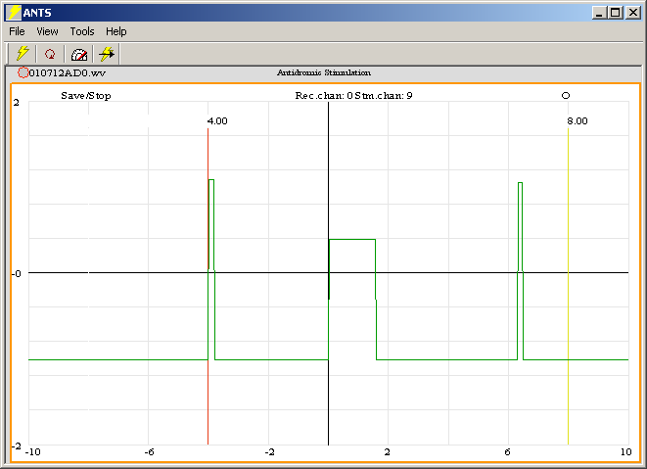
ANTS (ANTidromic Stimulator)
Faster pace stimulation
Orthodromic stimulation
Only for Antidromic Stimulation
Periodic automatic stimulation mode
Start Antidromic Stimulation
Click this to set the channel to record from, and the channel that is being stimulated
File name to save
Click this to save/stop saving
Click the labels to change the scales of axes.
Measuring bar that can be mouse-dragged to position at different time points. In the case of antidromic stimulation, this also sets the stimulation latency. Remember that the stimulation is triggered by the threshold crossing of the spike (you can see it by inspecting the point when the spike aligns with the measuring bar).
Stimulation
Another measuring bar. No function associaed

Slide 35
ANTS (ANTidromic Stimulator)
To create a new configuration with a different number of figures (similar rules apply to most of the other programs):
Delete all the figures: Right click and select the “delete” option for all the existing figures. Better yet, select only one figure and right click to bring up a context menu and select “Delete the rest” to close all the figures except the selected one; and, delete the selected one.
After closing all figures, it will bring up all the available channel figures for you to reconfigure. After setting the figure configuration, save this setting: File->Save_Config.
In the example above, 20 channels are active. DAS displays only the channels that are available: by default 2 channels; so you will see only 2 channels when you delete all the figures. To change this setting see the next slide.

Slide 36
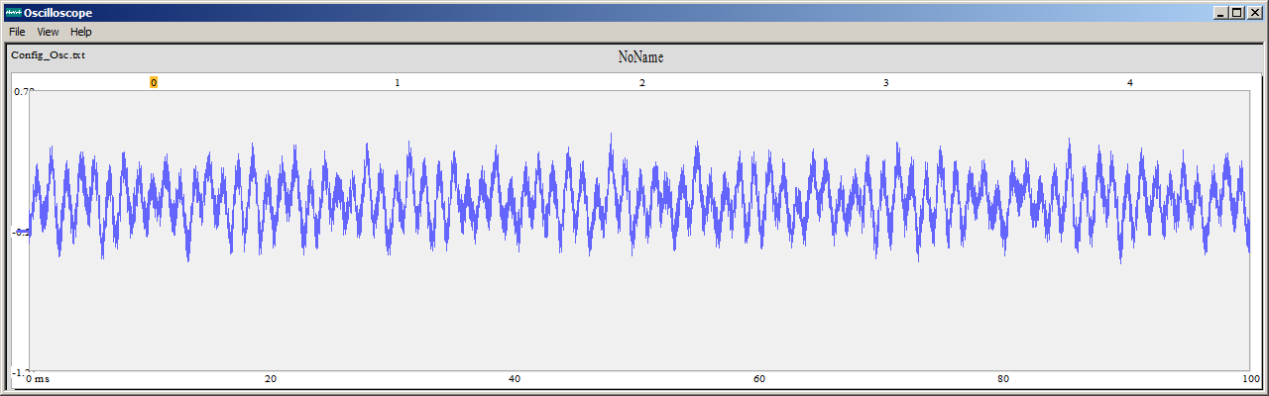
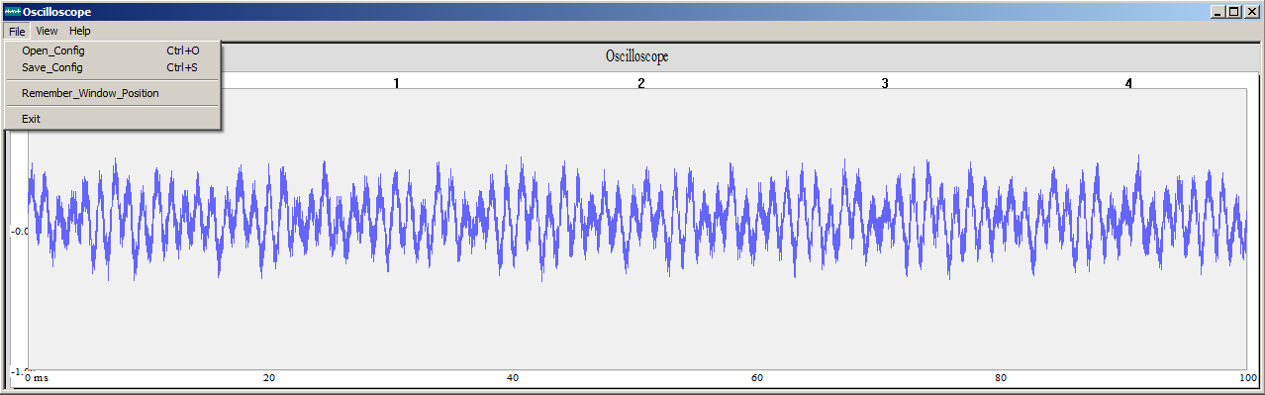
Oscilloscope
It just displays the currently available signal in any AI channel.
Currrently displayed channel (clickable)
Click the labels to change the scales of axes.
You can recall the size and position of the current window later: File→Remember_Window_Position

Slide 37
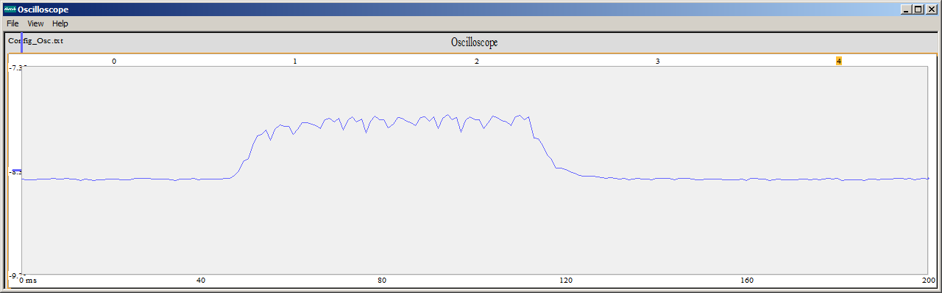
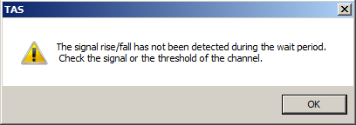
To use the photo-diode to detect the onset of display
Set a photo-diode on the upper-left corner of the screen where the flashing square is located signaling the onset and off set of a display. And feed the +/- wires of the photo-diode directly to one of the analog inputs. Use the “Other AI” channel for this (see NUM_OTHER_AI_CH & FIRST_OTHER_CH_DIX in “SharedConstants.h”).
Open “Oscilloscope” and click the photo-diode AI channel (in the following example “4”) to visualize the rise of the signal when the display is on/off. And set the threshold to detect the rising part of the signal. The threshold bar is located on the left side of the figure; grab with the mouse and move up/down. When you set the threshold, the program will automatically save the value in the hard drive, so that you don’t have to do it again.
In your task, use PvisSwitchStim_with_ECODE_atThresholdcrossingInChX(int N, int ObjArray[], int Switch[], int ECODE, int ChX) function to unveil the display object that you made and give the channel number “ChX” to indicate the photodiode AI channel. That’s it.
*When you use PvisSwitchStim_with_ECODE_atThresholdcrossingInChX( ) function, it will let you know if the display is on but there is no rising signal within 100ms. This is done by a warning dialog:
Currently visualized channel (ChX)
Threshold bar

Slide 38
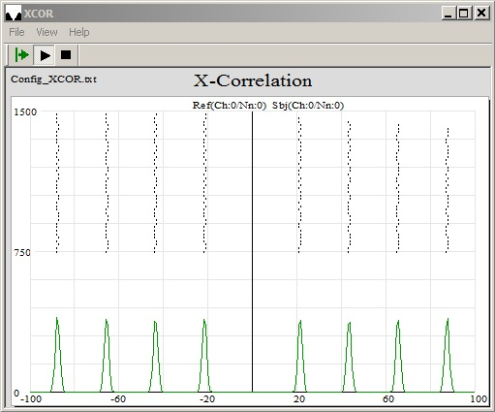
X-correlation
(also auto-correlation)
Stop/Pause
Start
Start afresh
Click the labels to change the Reference/Subject neurons’ channel # and the neuron #.
Click the labels to change the scales of axes.

Slide 39
X-correlation –Under the Hood
(also auto-correlation)
Subject spike
m_dMinX
0
Reference spike
m_dMaxX
m_HalfKernel_ms
m_PreSpikeTimeWnd
m_PostSpikeTimeWnd
m_HalfKernel_ms
When the XCOR is started, by the user,
Detect any newly occurring spike from the “Reference” neuron. If detected,
Wait for m_PostSpikeTimeWnd+ half Gaussian (the half size of the convolution kernel), and then
Search for the spikes by the “Subject” neuron within the time window of from –(m_PreSpikeTimeWnd + m_HalfKernel_ms) to (m_PostSpikeTimeWnd+ m_HalfKernel_ms) centered at the time of the Reference spike.
Using a temporary array, calculate the one-time X-Correlation between the Reference spike and the Subject spike within the time window of the X-Correlation: m_TmpXCOR[xcorIdx];
Add this one-time X-correlation array to the “accumulated” X-Correlation array using a weighting process. For example, if this is the 10th spike of the Reference Nn, then multiply 0.9 to the existing X-correlation curve; and the new signal’s contribution would 0.1 (1- 0.9 = 0.1). m_XCOR[xcorIdx]=0.9*m_XCOR[xcorIdx]+0.1*m_TmpXCOR[xcorIdx];
Go to (1).

Slide 40
Supported features by TAS
ECodes:
ECodes can be any (positive or negative) integer (32 bit: ±2,147,483,648; 64 bit: ± 9,223,372,036,854,775,807 ).
Use “StartCollectingTrialData_Give_StartECode_and_TrialID(ENABLECD, m_trialID)” to inform TAS to register the beginning of the trial.
In other occasions, use “Ecode(TGTCD)” to register the ECode.
Alias instead of ECode:
A few (see, MAX_NUM_OF_ECODES_IN_ALIAS_TABLE:~6) Ecodes can be displayed in the Running-Line display as a “word” instead of a number.
The number is limited because of the speed and the color available (Red, Orange…. DarkBlue).
Other services, such as “Trigger Status”, support alias associated with any ECodes.
To use an alias use ECode_as_Word() function. E.g.: “ECode_as_Word(ENABLECD,"Start")”.
Real time display of variables:
The running-line display can display several (as the space of the figure permits) variables in real time.
Use “Give_Nickname_VariableItself_FigIdx_Left0OrRight1Axis_IsToShowRunLine_MultiplyThis_AddThis ("Trial#",m_TrialNum, 0, USE_RIGHT_AXIS, NO_SHOW_IN_RUNNING_LINE_DISP,1,1)”.
The variables will appear as numbers (given) and running-lines (optional, e.g. NO_SHOW_IN_RUNNING_LINE_DISP).
Pictures as visual stimuli:
The VIS can accept pictures as stimuli: can read “bmp, gif, jpg, ico, emf, wmf” files
Can resize, re-position, present on a user-set background.
Use “Give_ObjID_and_NameOfPic(0,"BabyMonkey.jpg")” to set an object with a picture.
The first variable is the index of the picture stimulus object, the second one is the name of the picture.
The picture needs to be in “Blip\VIS_Figures\”.

Slide 41
Supported features by TAS
Accurate/non-accurate Timing:
Use “SleepAccurate(Fixed_duration_of_delay, Variable_duration_of_delay)” for accurate delay.
This function has micro-second scale resolution. However, this function is computationally expensive.
Use “Sleep_NOT_Accurate(Fixed_duration_of_delay, Variable_duration_of_delay)” for non-accurate delay.
This function has millisecond scale resolution. This function is computationally “cheap”.
Accurate timing with escape conditions:
For the occasions where you need to give the subject an interval of time in which you monitor the subject’s behavior and do something depending on the outcome of the behavior, use the following lines:
BeforeEscapeConditions(TimeDurationInMS)
        //######### Describe your escape conditions below #########
        if(wrongSacDir==1){goto failedSaccade; } //“Catch of eye” function is running background.
        if(IsEyeIn(posBOX1,m_EyeID)==1){goto gazeHold;}
        //######### End of your escape conditions #################
        AfterEscapeConditions
        This “BeforeEscapeConditions(TimeDurationInMS) … AfterEscapeConditions” has a built in sleep of 1ms that it will check the user defined escape conditions every 1 ms until time “TimeDurationInMS” runs out.
Eye (or any XY) position monitoring functions:
int WaitUntilEyeIsIn(posBOX0/*Eye window ID*/, m_EyeID/*EYE ID*/,1000 /*How long*/,-1/*variable duration*/)
int WaitUntilEyeIsOut(posBOX0,m_EyeID,dur_Waitfx,-1)
int IsEyeIn(posBOX1,m_EyeID)
Digital output:
Use “Relay_ON(RWD/*Digital Output channel*/)” to send out a TTL pulse to a digital output line (in this case a reward).
Digital Input

Slide 42
Visual C++ programing (please read this page, rookies!!)
Please read the following, it will save you hours of agony!!
Use the “Call Stack” feature of the VC++. It will show you all the step by step progress of your program.
The best part of VC++ is its great support to Debugging. Use Ctrl+F10 (run to the line), F10 (next line), F11(Go inside a function), to utilize this feature. Also Ctrl+F and Ctrl+Shift+F are quite useful.
When you execute programs by clicking icons in MOXY, or, when the MOXY starts and auto-triggers other programs, it is the RELEASE version of the program that’s triggered. If you have changed a program in Debug mode, the change WILL NOT be reflected in the icon/auto-triggered programs. Also if your setting is x64 bit, the auto-trigger will look for the x64 bit version, not x32. So always make sure you are in the right mode (debug/release, x32/x64).
Sometimes, the most tricky debuging problem is when the results in Debug mode and Release mode are different. For example, the program runs okay in Debug mode but crashes in Release. It is mostly because the Debug mode initializes all variables to zero (at least in VC++ 2012), but Release mode does not. This makes a huge difference, for example, when the variable is an index of an array or something. So if this happens, make sure you have properly initialized variables.
It is quite RARE but you may encounter a bug of VC++ itself. In this case, try to clean and rebuild, or reboot the computer. In the case this does not work, use other methods to work around.
*I myself am not a professional programmer either, just a scientist knowing how to program. You will see what I mean when you see the details of the coding. If you find a better AND easier solution of certain parts of the program, please let me know. If you know a better but difficult solution then please keep it to yourself; I have everything but time. If you find serious bugs please let me know: simonblip@gmail.com . You received free, give free.

Slide 43
How to customize Blip for your needs:
An example (Fixation Task)
First: Design the task
Pre-trial period
A fixation stimulus comes on
The program waits up to 1000ms for the subject to fixate
The subject fixates
Keep fixating for 500ms
Give reward with a sound of tone
Post-trial period.
Go to 1.
No fixation? Give a “beep” and restart a trial
Failed to stay fixated? Give a “beep” and restart a trial

Slide 44
Example - Fixation task, the subject gets juice just by fixating at a dot on the screen
(1) Declare the functions and variables
The “Task Scheduler” (TAS) will be the one you need to modify to make your own tasks.
“TAS_View.h” file has the “declaration” of the functions and variables used in the tasks
class CTASView : public CView
{
  //############## Your new task, here! ###############
  void InitVariables_MyNewFixTask();
  void MyNewFixTask();
  int myFix_Switch[2], m_FixAtCenter0_RandFix1_UserXY2;
  //#################### 1DR ######################
  …
  //################## Saccade task ##################
  …
  //##### Some shared variables across different tasks ######
  …
  //################################################
  //Parallel Threads
  ….
  };
Your new task here!
Othere existing tasks
Shared stuff across tasks (you can change thses)

Slide 45
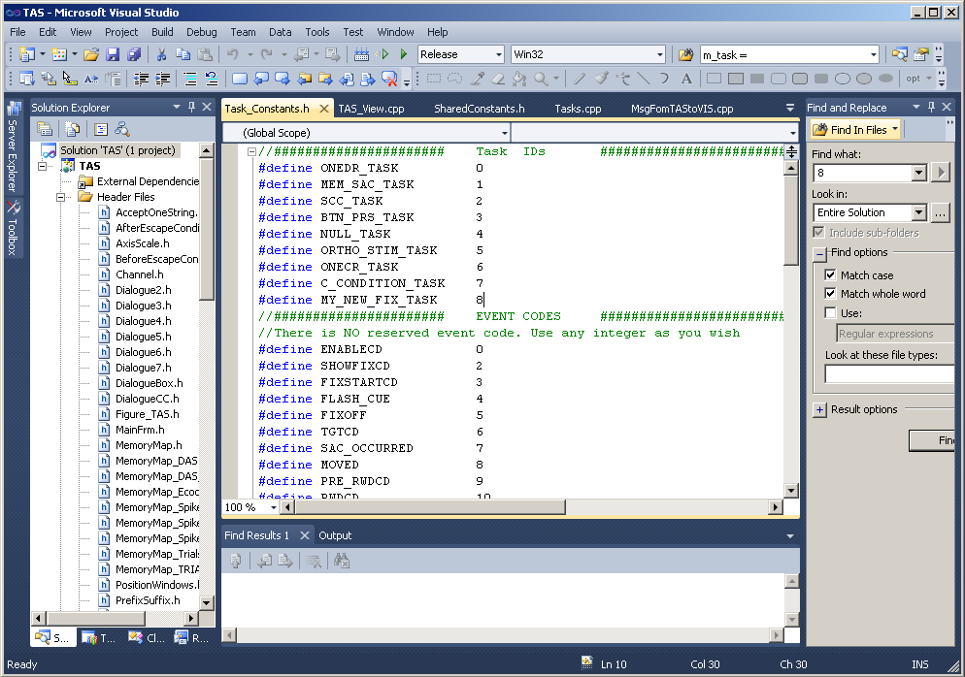
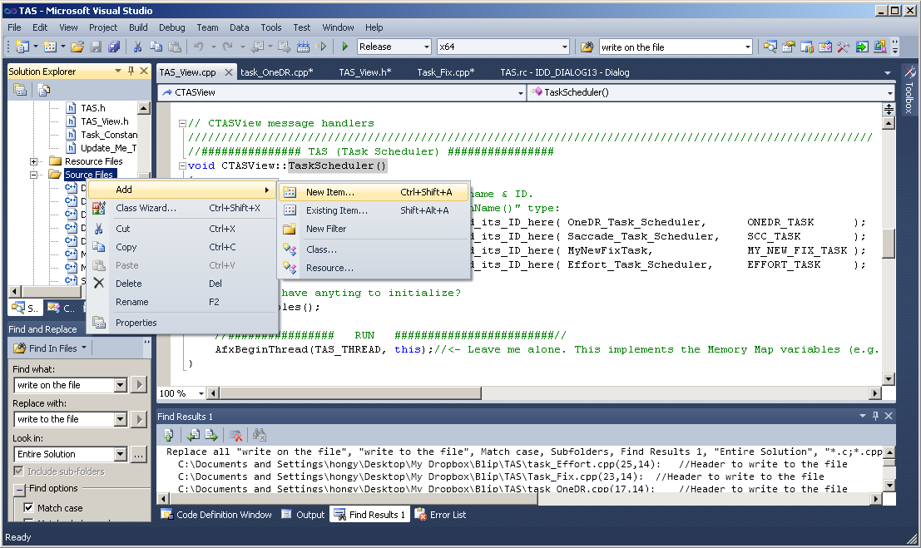
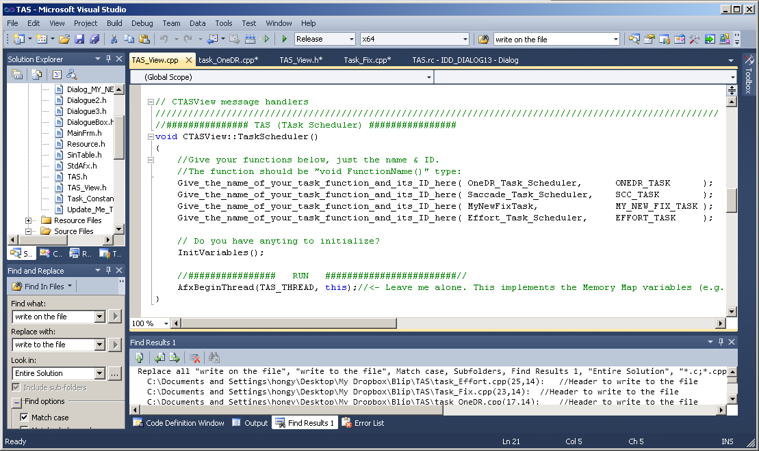
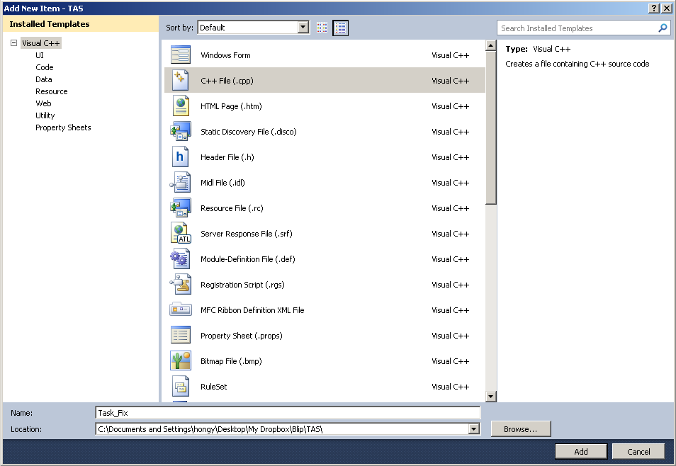
Example: (2)~
2) Open “Task_Constants.h” and register the number of the task
4) Create a new source file: Right click “Source File” and follow the menu
3) Open “TAS_View.cpp” and register the task function
5) Create a new source file. Here a file name of “Task_Fix.cpp” is given

Slide 46
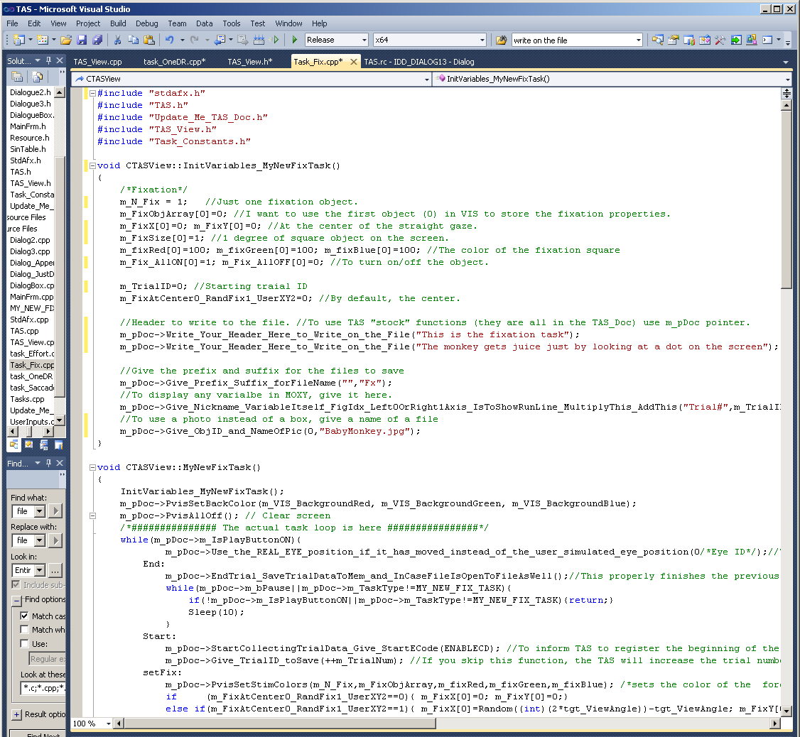
Example: (6) Write your own task code
6) The following figure shows a snippet of codes of the fixation task. It is well commented and the name of the provided TAS functions are quite narrative. All of the TAS functions are declared in “Update_Me_TAS_Doc.h” and implemented in “Update_Me_TAS_Doc.cpp” So when there is a new version of Blip, just copy these two Update_Me files and an Update_Me folder.

Slide 47
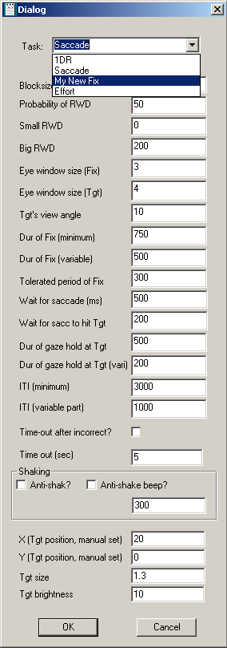
(7) Register to the drop-down Task menu table
1. Go to “CDialogueBox::OnInitDialog()” and add the name of the task:
m_TaskCombo.AddString("My New Fix");
2. Go to “CDialogueBox::OnCbnSelchangeTaskCombo()”, and add the name of the task and its value:
else if(strSelected=="My New Fix")m_TaskType=MY_NEW_FIX_TASK;
This will appear
Now you can click the task menu icon

Slide 48
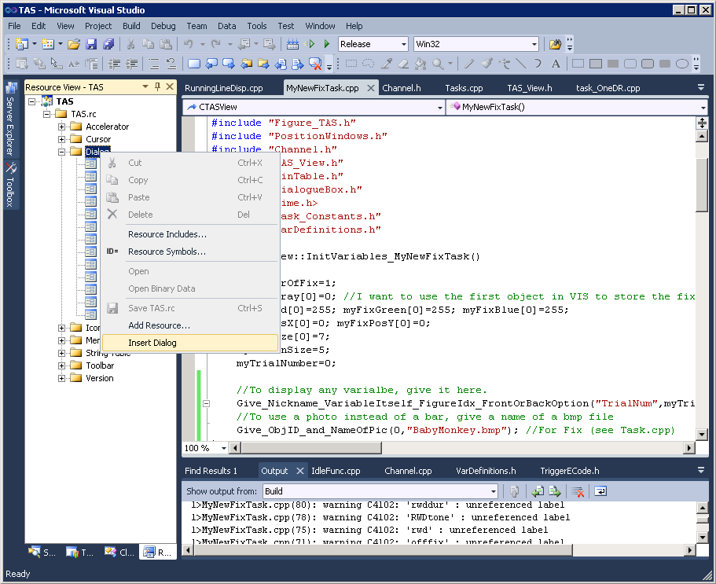
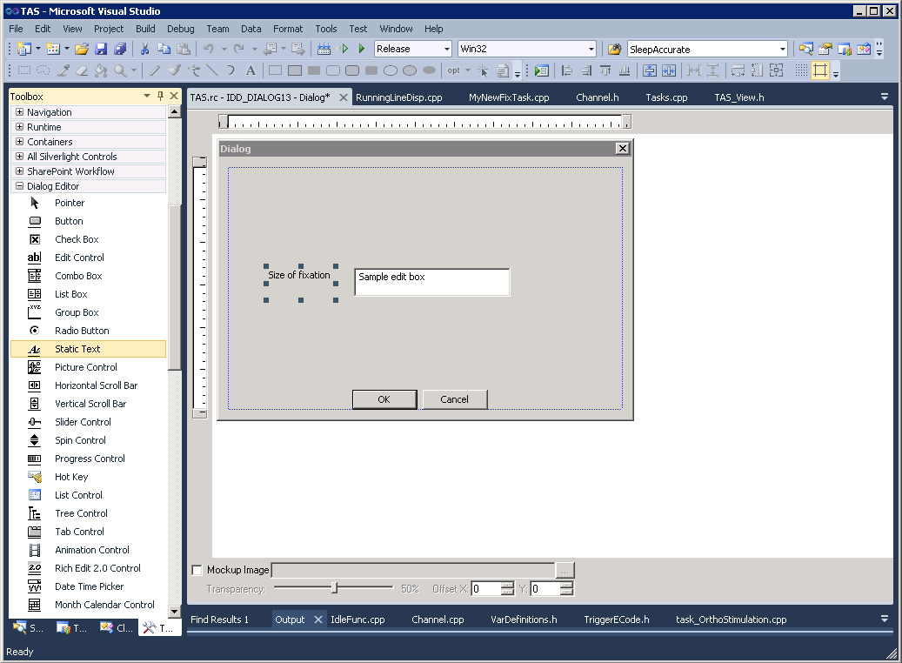
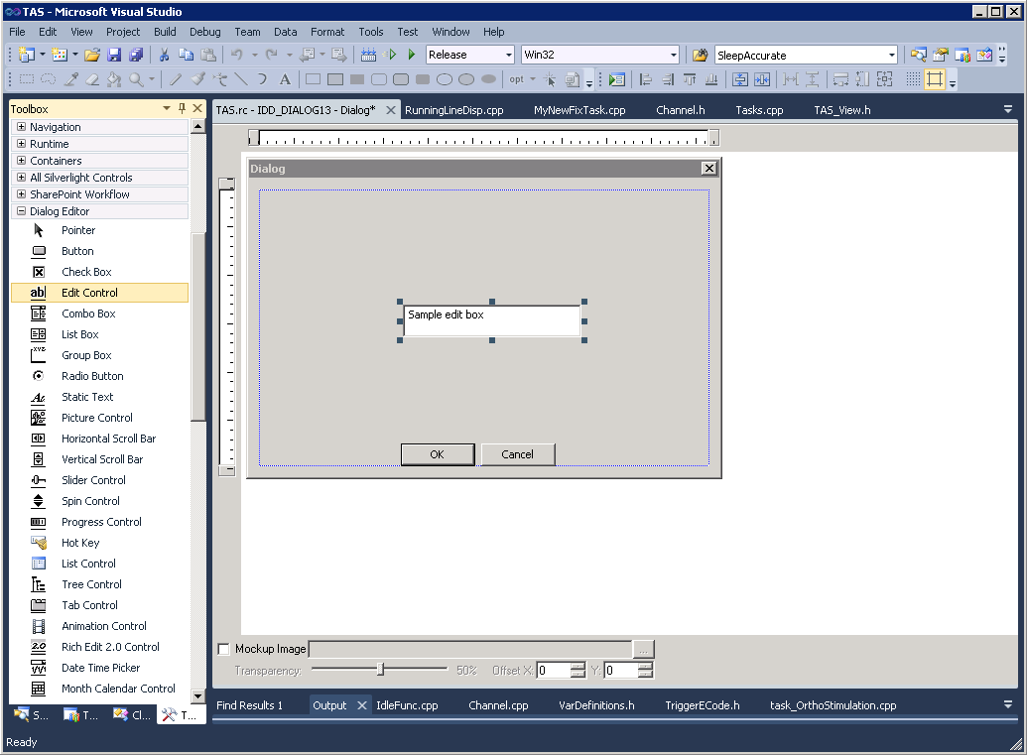
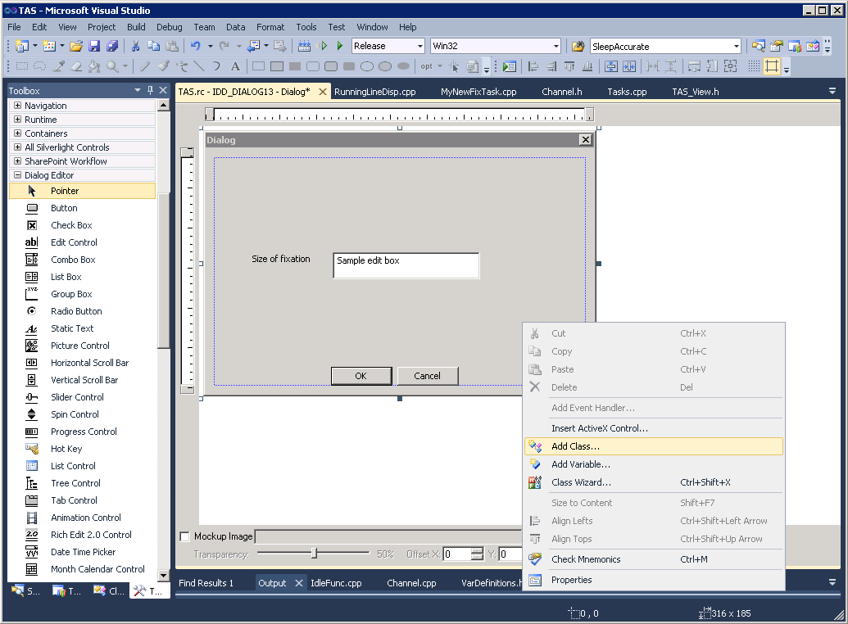
Add a Dialog to the task
1) Create a dialog (*Do not copy and paste other existing Dialog to creare a new one)
3) Give a description. This “static text” has no functional effect.
4) Right click the empty space of the Dialog to add a class to to the Dialog.
2) Create an “Edit box”

Slide 49
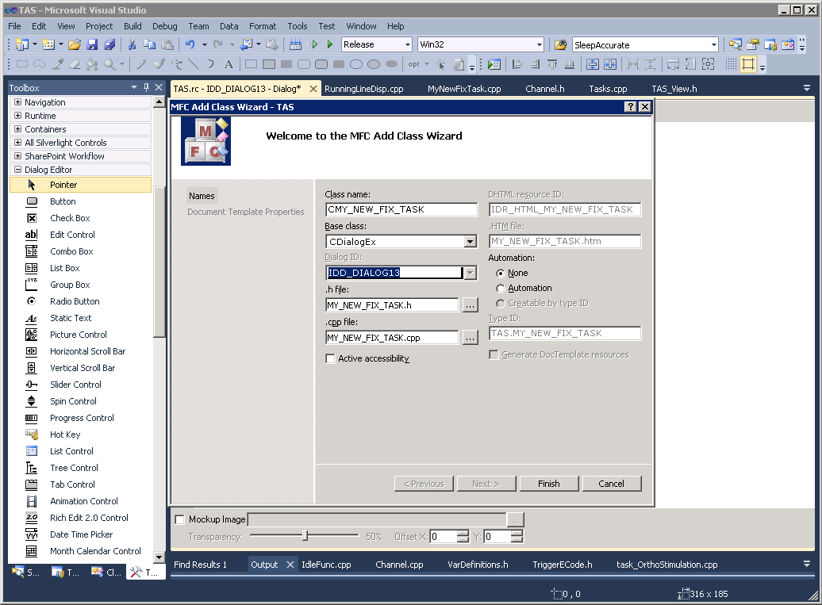
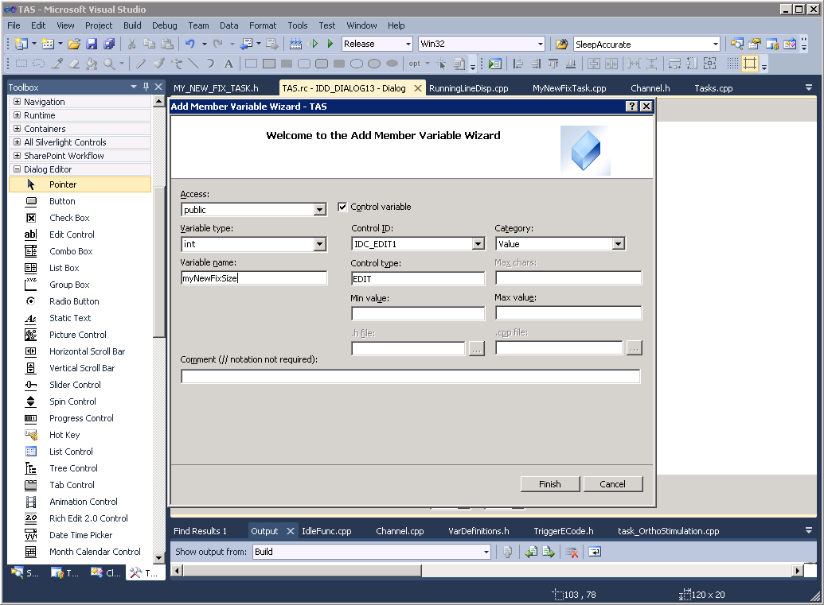
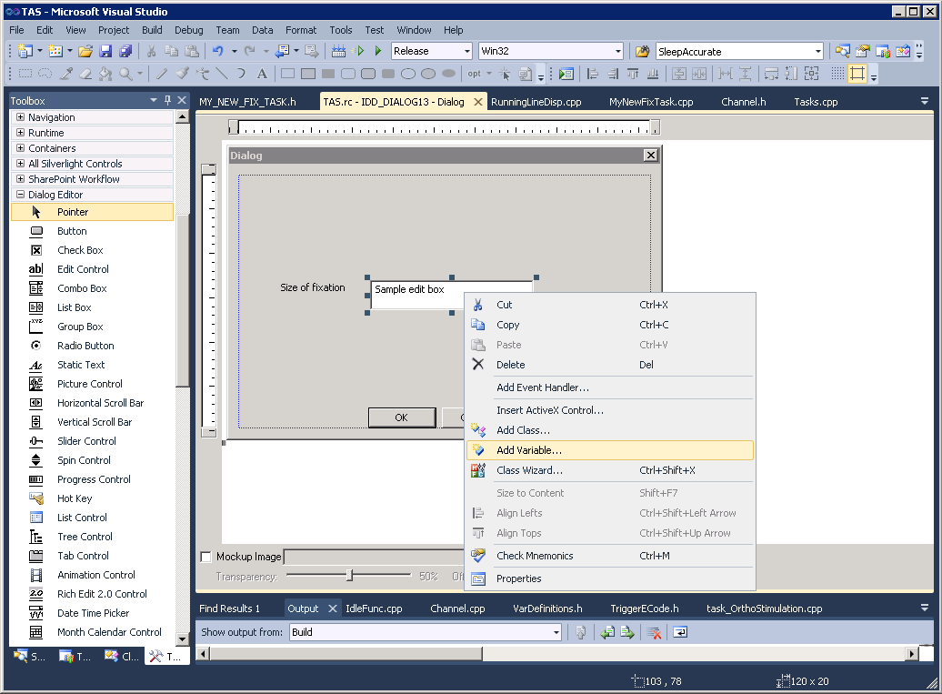
Add a Dialog
5) When a class wizard appears, type in the name of the class. And click “finish”.
7) Set properties, and give the variable a name, and Finish!
6) Go back to the Dialog and right-click the edit box to add a variable to it.

Slide 50
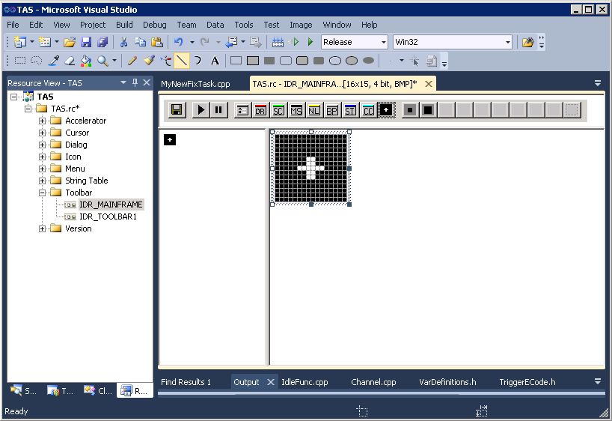
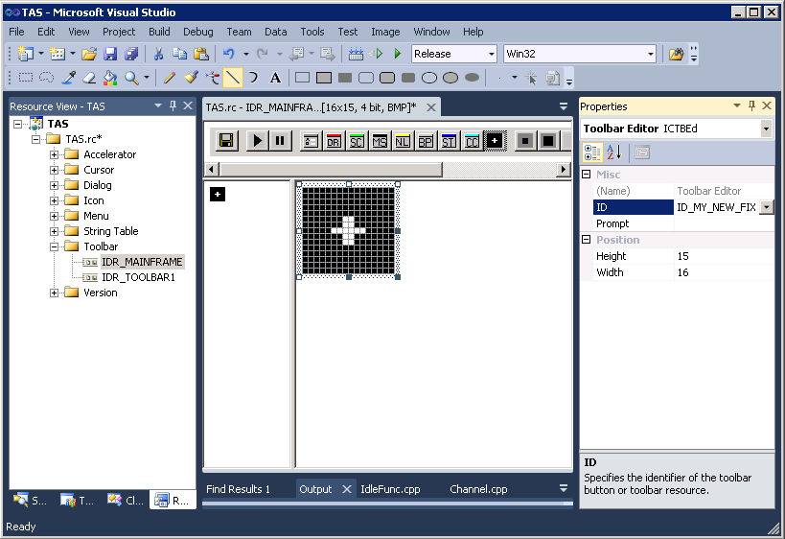
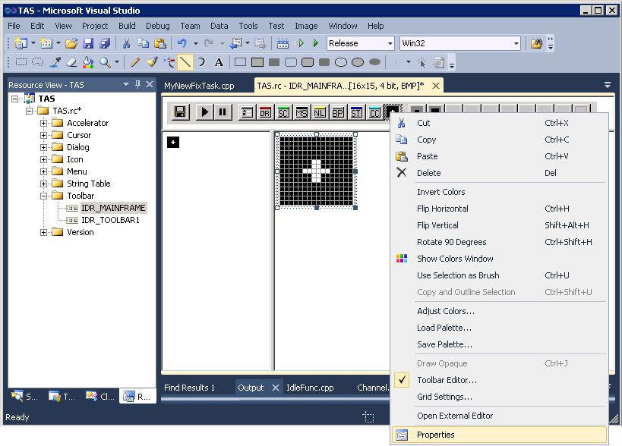
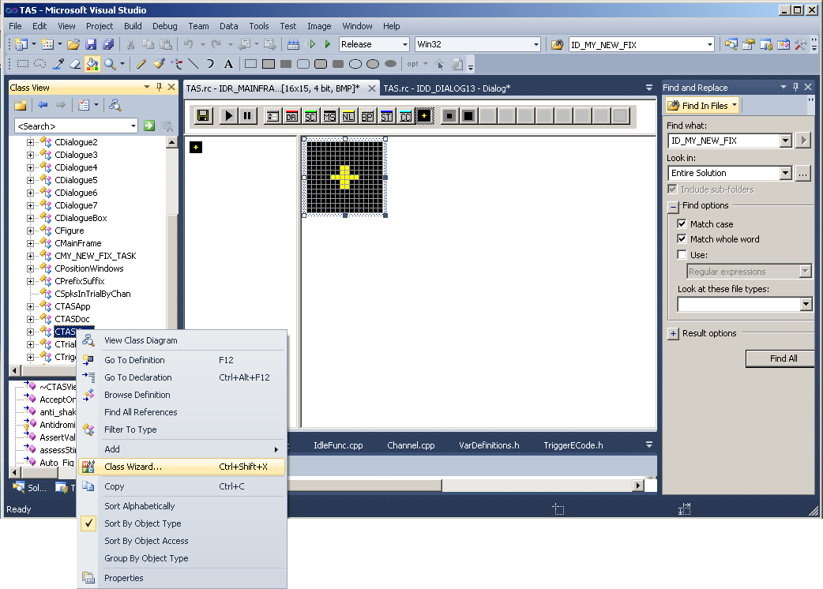
Add an icon
9) Bring up the icon editor, and use an empy icon to make your own icon (you need to draw).
11) Give an ID to the icon.
10) Right click the icon to bring up the property of the icon
12) Open the Class Wizard from CTASView

Slide 51
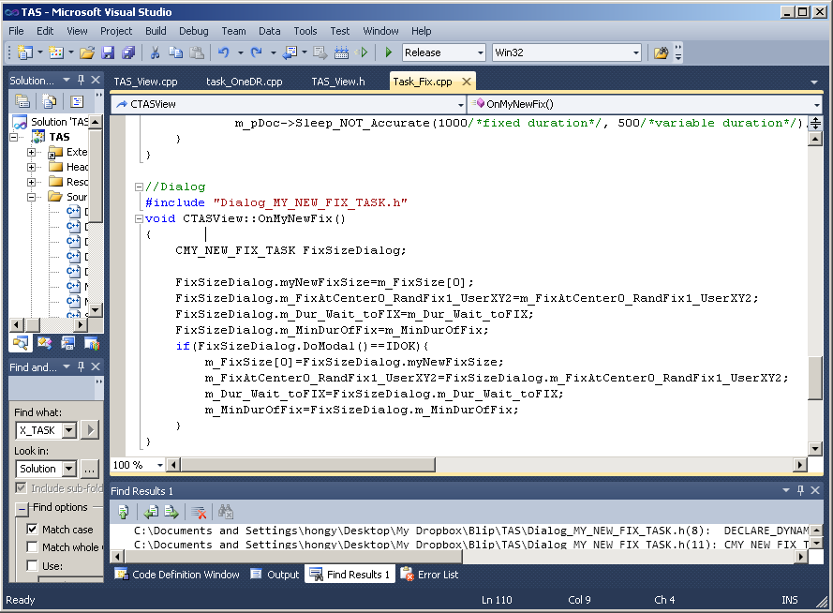
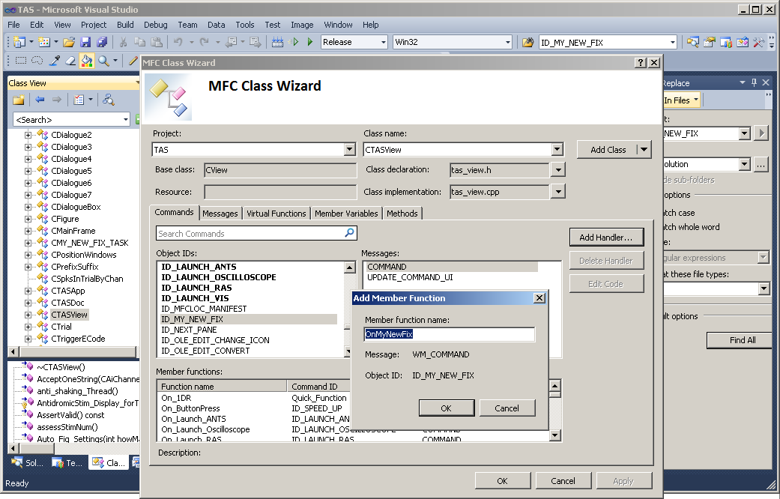
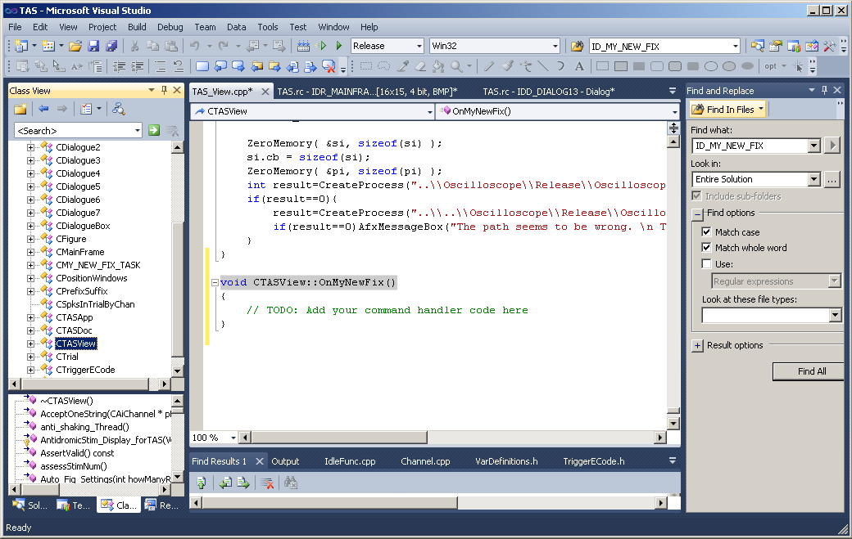
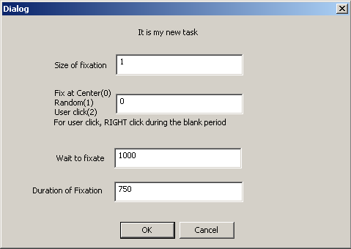
Write code to make a Dialog to accept values form the user
13) From Class wizard, select ID_MY_NEW_FIX, and then select COMMAND and then click “Add Handler…” →Accept the name of the function “OnMyNewFix” by clicking OK.
15) Write a code to accept a value form the user. (I moved the location of the file from TAS_View.cpp to MyNewFixTask.cpp just to keep things organized.)
(3)
(2)
(1)
(4)
14) This will bring up an empty function in the “TAS_View.cpp file.
16) Compile & use! I have added X, Y position method, how long to wait for the subject to fixate, and how long he needs to fixate.

Slide 52
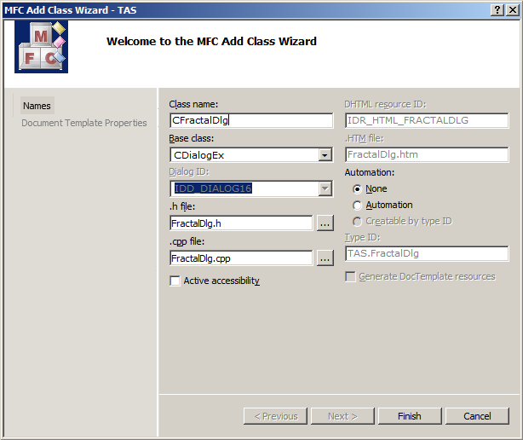
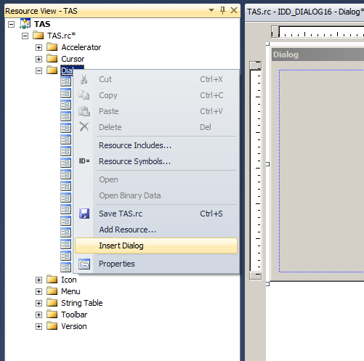
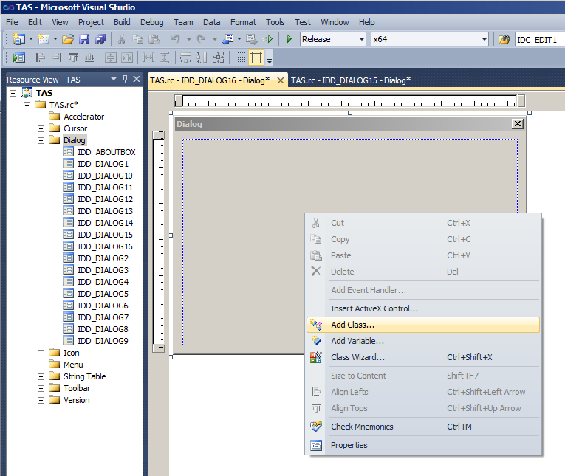

Drop-down menu (Combo box )
Note: Do not copy and paste other existing Dialog to create a new one.
Create a dialog by clicking Dialog folder icon in Resources and choosing “Insert Dialog”.
3) Give a name to the class “CFractalDlg” in the example below, and click Finish.
2) Add a class to the Dialog by right clicking the Dialog and selecting “Add class”.
4) Make an icon to call the Dialog that you just have made. To do that, click Toolbar directory and IDR_MAINFRAME. In the example an icon with a design “FR” was made by drawing the FR figure in an empty icon using the drawing tools provided. The example names the icon ID “ID_FRACTAL_TASK”.

Slide 53





5) Go to the Class View and right click the TASVIEW and choose “Class Wizard” to connect the icon to a function, which will be called when the user clicks the icon
7) Edit the function. In the example below, just an instance of CFractionDlg is declared and a response to an OK button is given.
6) Choose an Object ID, ID_FRACTAL_TASK in this case, and COMMAND in Message box. Click Add Handler. Accept (by OK button) the name of the function that will be generated. And click OK to finish the class wizard.
8) Compile and run TAS. Click the button to evoke the Dialog that you have created.
If you see something like the following you have succeed.

Slide 54




9) Add a combo box to the Dialog by clicking “Combo Box” in Toolbox and then clicking on the Dialog panel.
11) Add a combo box variable (instance) to the Dialog class, in this example to CFractalDlg, by right clicking the combo box and choosing “Add variable”.
10) Click the dropdown button of the dropdown menu. Now it will let you drag the window down-ward to allow the dropdown menu to expand when it is clicked.
12) Give a name for the variable. In the example below “m_FractalComboBox”. And click Finish. This will add an instance of the ComboBox, named m_FractalComboBox, to the Dialog class.

Slide 55




15) Also add a virtual function by the Class Wizard. After choosing the right class and function, click “Add Function”. And click “Edit Code”.
13) Connect the combo box to a function in case the user clicks it: Right click the combo box and click “Add Event Handler”.
16) Edit appropriate operations in the functions. In the following, the user is giving 3 different task choices to the combo box drop-down menu.
14) Make sure that the CBL_SELCHANGE is selected and the right Dialog class is selected. See the name of the function is okay. And just click the button “Add and Edit”.

Slide 56


17) Go to TAS_VIEW.cpp to further define the function that calls the Dialog.
18) Build the program and run it. You should be able to click and see the Dialog and change the parameter using the drop-down menu.

Slide 57
Typical functions to present visual stimuli
Typical functions to present BOX stimuli:
1) PvisSetStimColors(nFix,fixObj,fixRed,fixGreen,fixBlue);
2) PvisStimLocation(nFix, fixObj, fixX, fixY);
3) PvisDrawBar(nFix, fixObj, fixSize, fixSize, ContrastOfBars);
4) PvisSwitchStim_with_ECODE (nFix, fixObj, fix_SwitchON, Ecode);
Typical functions to present PICTURE stimuli:
1) Give_ObjID_and_NameOfPic(0,"BabyMonkey.jpg");
2) PvisStimLocation(nFix, fixObj, fixX, fixY);
3) PvisDrawPic(nFix, fixObj, fixSize, fixSize);
4) PvisSwitchStim_with_ECODE(nFix, fixObj, fix_SwitchON, Ecode);
* The figures should be at “Blip\VIS_Figures\” folder.
*PvisSwitchStim_with_ECODE( , , , ecode) function turns visual stimuli on or off; right after the execution of this stimuli manipulation, an ecode will be entered. If you don’t want to enter any ecode, put NO_ECODE in place of your ecode.

Slide 58
How to save your trial data
To start collecting your data, simply insert the following function:
(1) m_pDoc-> StartCollectingTrialData_Give_StartECode(ENABLECD);
At one point of the trial, add the following function to indicate the trial number to be saved.
  (2) m_pDoc->Give_TrialID_toSave(m_TrialNum); //If you don’t give this, TAS will automatically increase the trial # by 1.
To end the trial and save the data call the following function:
(3) m_pDoc->EndTrial_SaveTrialDataToMem_and_InCaseFileIsOpenToFileAsWell();
If you intend to collect all the data connecting trials back to back, place the above (1) and (3) functions back to back with a pause loop in between:
    void CTASView::MyNewFixTask()
    {
      InitVariables_MyNewFixTask();
      m_pDoc->PvisSetBackColor(m_VIS_BackgroundRed, m_VIS_BackgroundGreen, m_VIS_BackgroundBlue);
      m_pDoc->PvisAllOff(); // Clear screen
      /*############### The actual task loop is here ################*/
      while(m_pDoc->m_IsPlayButtonON){
        m_pDoc->Use_the_REAL_EYE_position_if_it_has_moved_instead_of_the_user_simulated_eye_position(0/*Eye ID*/);.
    //Save data for the trial
        m_pDoc->EndTrial_SaveTrialDataToMem_and_InCaseFileIsOpenToFileAsWell();//This properly finishes the previous trial.
        while(m_pDoc->m_bPause||m_pDoc->m_TaskType!=MY_NEW_FIX_TASK){
          if(!m_pDoc->m_IsPlayButtonON||m_pDoc->m_TaskType!=MY_NEW_FIX_TASK){return;}
          Sleep(10);
        }
        //Start a new trial and start collecting data for the trial to save at the end.
        m_pDoc->StartCollectingTrialData_Give_StartECode(ENABLECD); //To inform TAS to register the beginning of the trial, use this function.
        m_pDoc->Give_TrialID_toSave(++m_TrialNum); //If you skip this function, the TAS will increase the trial number by 1 every trial.
        …
      }
      }

Slide 59

Continuity of data saving
      Ali ran a MatLab to see how the Blip saves analog data using the following configuration:
      //Save data for the trial
        m_pDoc->EndTrial_SaveTrialDataToMem_and_InCaseFileIsOpenToFileAsWell();//This properly finishes the previous trial.
        //Pause loop
        while(m_pDoc->m_bPause||m_pDoc->m_TaskType!=EFFORT_TASK){ … }
        //Start a new trial and start collecting data for the trial to save at the end.
        m_pDoc->StartCollectingTrialData_Give_StartECode(ENABLECD); //To inform TAS to register the beginning of the trial use this function.
        The following histogram shows the distribution of the time gap between the last data point of one trial to the first data point of the next trial. As the result shows, the Blip has about 1ms of data gap between trials.
      Data
      *NOTE:
      Blip records all the open behavioral AI channels’ (specified by NUM_BEHAVIOR_AI_CHANS) data. Since each AI tends to take up a lot of disk space, it is a good idea to keep the number of behavioral AI channels to minimal.
      Also, even when you click MOXY's eye monitor and the running line's eye position level changes, it is not reflected in the saved file. The data saved are the ones only from the NI instrument, i.e., M_AI[..]. You can see this at “void CTASView::Serialize(CArchive& ar)”.

Slide 60
File saving – Under the hood
      To make the data collecting and file writing process more efficient, Blip uses alternating memory spaces for Ecodes, Spikes, User defined variables) one for the previous (to a file on the hard drive), another for the current trial (to memory). An illustration is shown below.
      For the analog signals, a long loop is used to separate the previous trial’s data from the current one. See the illustration below.
      At the end of the trial, the save function takes off as a parallel thread. While the data is being written in the hard drive from the memory, the next trial may have already started and collecting the data to the memory. Because of this parallel structure, the data gap between trials is minimal and the current trial variables are safely collected regardless of the previous data that is being written to a file.
      To make sure that the analog data of the previous trial is well separated from the current analog writing position for the current trial, the program checks the memory positions before writing the data to the hard drive. If the queue is too small to be safe, Blip will give you a warning (see “At_the_End_of_a_Trial_Check_if_MemoryMap_config_meets_the_trials_config()” function for details).
      Ecodes, Spikes & User defined variables
      Analog signals
      Current trial data; collected to a memory space
      End of previous trial
      Start of previous trial
      Memory space 1
      Memory space 2
      Previous trial data; gets written to a file at the end of a trial.
      Start of current trial
      Gets written to the file at the end of the trial.

Slide 61
File saving – Neural Spike saving
EndTrial_SaveTrialDataToMem_and_InCaseFileIsOpenToFileAsWell() & Serialize() in Update_Me_TAS_Doc.cpp in TAS
*M_NumChansHavingSpikes[TrlIdxInMap]==2
*M_ChanIDsHavingSpikes[TrlIdxInMap][0:1]=={0, 2}
ChanID==0
ChanID==2
*M_NumNnsInChanHavingSpikes[TrlIdxInMap][0]==2
*M_NumNnsInChanHavingSpikes[TrlIdxInMap][2]==1
*M_NnIdWithSpk[TrlIdxInMap][0][0:1] =={0, 1}
*M_NnIdWithSpk[TrlIdxInMap][0][0:0] =={1}
NnID==0
NnID==1
NnID==1
NumSpks==3
NumSpks==2
NumSpks==5
Spk1, Spk2, Spk3.
Spk1, Spk2
Spk1, Spk2, Spk3, Spk4, Spk5,
There are three of the above structure in Blip: TrlIdxInMap==0, TrlIdxInMap==1, TrlIdxInMap==2.
These three memory spaces take turns recording the current trial.
This is to make the saving process a completely different thread independent of the task thread.

Slide 62
.RST file structure
Objective: If the trials are executed in succession, without break, all the event-, spike-, ( and analog-data if desired) need to be reconstructable as continuous events in time. For this, spikes need to be recorded until the beginning of the next trial. (see void CTASDoc::Serialize(CArchive& ar))
int m_LengthOfHeader
CString m_Header
int Trial ID
long long m_StartTimeOfTrial (== m_EventTime[0])
long long m_EndTimeOfTrial (the last SpikeTime[ ])
int m_numEventCodes
int m_EventCode[ ]
long long m_EventTime[ ]
Header
Event Code
int m_NumOfUserData
{
  int m_SizeOfName (number of characters in Name[ ] )
  char Name[ ]
  int m_NumOfValues (number of values)
  double Value1, Value2, Value3, …
  long long m_TimeOfOccurrence
  }
  {…}
User-defined Structured Data
One trial
m_numNeuralChan
{
  m_ChanID
  m_numNns
  m_numSpikesOfNn1, m_SpikeTimeNn1[ ]
  m_numSpikesOfNn2, m_SpikeTimeNn2[ ]
  m_numSpikesOfNn3, m_SpikeTimeNn3[ ]
}
{…}
Neural spike data
m_SamplingRate
m_StartTimeOfAI
m_EndTimeOfAI
m_numBehaviorChannels
{
  channelID
  m_numDataPointsOfBehaviorAI
  m_AnalogSignal1[ ]
  }
{…}
  …
Analog data
Another trial
int Trial ID

Slide 63
_Utilities
Currently, there are 5 utility programs coming with Blip:
(1) Trialviewer
  This program visualizes the saved “.rst” files.
  Click the folder icon to open a file.
  To see different trials, use ← and →.
  To see different neuronal data, click “Ch:0/Nn:0”.
  The first two rows of text at the top portion are Ecodes; they are color coded.
  The next below appear the “User-Defined-Data”; they are color coded.
  Analog signals appear in red and blue.
(2) Update_existing_Blip
  This program comes with a new release of Blip package. If you have an existing Blip, you may want to run this program to update the old Blip parts. Your TAS_view part, in which you are supposed to implement your tasks, will not be touched. When you execute this program, it looks if it has been executed in the “New_Blip” folder and “New_Blip” folder contains “Blip” folder deemed to be the new one. You get to confirm which Blip is your existing Blip folder and which is the new Blip, before this program finally takes an action to replace the needed files and folders.
(3) File Cleaner
  This program is used to remove redundant files and folders in Blip to release. This typically reduces the Blip more than 20 times of the original size. All the deleted files (see “If you would like to redistribute” slide for further details) will repopulate once the user recompiles the programs. Typically, *.exe files are not deleted so that the end user does not have to recompile the whole thing. To clean the Blip folder, just execute the program and follow the directions.
  (4) Get_Blip_Core
  This program is similar to the “File Cleaner”, but works in an “opposite” way; instead of removing redundant files, it copies only the needed files of the program. This way it saves time of copying the whole Blip and removing the unnecessary files. To copy the core of Blip to redistribute, just execute the program and follow the directions.
(5) Blip Launcher
  This program detects your operating system and launches an appropriate version (either x64 or x32) of TAS.exe. It may be better to just execute TAS.exe if you know your system.

Slide 64
How to add a memory map variable:
Copy & past an existing variable, and rename it.
1. Go to the declaration header file (e.g., MemMap_Decl.h). Copy and paste an existing variable (e.g., M_is_LFP_saving) with the same data type (e.g., int), and rename it to a desired one (e.g., M_StimulatingChanIdxToSave). Change all the related names (e.g., hFile_M_is_LFP_saving -> hFile_M_StimulatingChanIdxToSave) as well (by using the Find options “Match case” checked and “Match whole word” unchecked. Remember to change the size of the variable (e.g., 1 * sizeof(int) above) to an appropriate value.
e.g.:
    HANDLEhFile_M_is_LFP_saving; int *M_is_LFP_saving;
    HANDLEhFile_M_StimulatingChanIdxToSave; int *M_StimulatingChanIdxToSave;
3. Go to the creation implementation header file the variable (e.g., MemMap_Open_DAS.h). And copy and paste the whole block of codes creating a variable (e.g., M_is_LFP_saving)
    e.g.:
    //M_is_LFP_saving
    sprintf(NameOfMap,"Map_M_is_LFP_saving");
    if(IsToCreate==1)hFile_M_is_LFP_saving = CreateFileMapping(INVALID_HANDLE_VALUE, NULL,PAGE_READWRITE, 0, 1 * sizeof(int), NameOfMap);
    else hFile_M_is_LFP_saving = OpenFileMapping(FILE_MAP_ALL_ACCESS, FALSE, NameOfMap);
    if(hFile_M_is_LFP_saving == NULL){AfxMessageBox("Unable to create/open Map_M_is_LFP_saving's shared memory area."); exit(1);}
    M_is_LFP_saving = (int*) MapViewOfFile(hFile_M_is_LFP_saving, FILE_MAP_ALL_ACCESS, 0,0,0);
    if(M_is_LFP_saving == NULL){AfxMessageBox("Unable to create/open a VIEW."); exit(1);}
    4. Change the existing name to a desired one (e.g., M_StimulatingChanIdxToSave) in the newly copied block. Change all the related names (e.g., hFile_M_is_LFP_saving -> hFile_M_StimulatingChanIdxToSave) as well (by using the Find options “Match case” checked and “Match whole word” unchecked. Remember to change the size of the variable (e.g., 1 * sizeof(int) above) to an appropriate value. Also make sure that the data type is correct (e.g., (int*) MapViewOfFile(…)).
    5. Go to the destruction header file the variable (e.g., MemMap_Close_DAS.h). And copy and paste the whole block of codes destroying a variable (e.g., M_is_LFP_saving)
    e.g.:
    //M_is_LFP_saving
    if(!UnmapViewOfFile(M_is_LFP_saving)){ AfxMessageBox("Could not unmap view of file.");}
    CloseHandle(hFile_M_is_LFP_saving);
    6. Change the existing name to a desired one (e.g., M_StimulatingChanIdxToSave) in the newly copied block. Change all the related names (e.g., hFile_M_is_LFP_saving -> hFile_M_StimulatingChanIdxToSave) as well.
    *Remember to initialize the value in the program as needed.

Slide 65
The shared memory structure between TAS, MOXY & VIS
Task Scheduler (TAS)
VISual displayer (VIS)
MOnitoring System (MOXY)
M_bufferMessage
(what message?)
Command: “PvisSetStimColors”
M_bufferMessage
Command: number (e.g., 2)
M_Msg_from_VIS_to_MOS
M_N
how many objects? 4
M_N
M_VisObjIDs[ ]
Indexes of those objects?
M_VisObjIDs[ ]
0
1
3
5
0
1
3
5
MAX_STIM_OBJ
Object 0
Object
MAX_STIM_OBJ-1
double M_cntrX[ ]; //1
double M_cntrY[ ]; //2
double M_width[ ]; //3
double M_hight[ ]; //4
double M_angle[ ]; //5
//int M_ContrastOfBars[ ]; //6
COLORREF M_rgb[ ];//7
int M_Ojb_Switch[ ];//8
char M_PicFileName[ ][64];//9
Typical functions to present a square on the screen:
1) PvisSetStimColors(nFix,fixObj,fixRed,fixGreen,fixBlue);
2) PvisStimLocation(nFix, fixObj, fixX, fixY);
3) PvisDrawBar(nFix, fixObj, fixSize, fixSize, ContrastOfBars);
4) PvisSwitchStim_with_EODE(nFix, fixObj, fix_SwitchON, ecode);
Typical functions to present a picture on the screen:
1) Give_ObjID_and_NameOfPic(0,"BabyMonkey.bmp");
2) PvisStimLocation(nFix, fixObj, fixX, fixY);
3) PvisDrawPic(nFix, fixObj, fixSize, fixSize);
4) PvisSwitchStim_with_EODE(nFix, fixObj, fix_SwitchON, ecode);
* The figures should be in “Blip\VIS_Figures” folder.

Slide 66
The shared memory structure of DAS server
crrntUsablelData_idx(created by SIG)
m_ThresholdXingSearchIdxi
*M_latestUsableDataIdx_4Analysis
m_SizeOfDataQueue-1
m_postWaveSpanDataSize
m_DataIdx_4DAQ
double M_AI[ ]
m_SamplesPerRead
__int64 M_timeStampMicS[ ]
=
g_PrvTime2RetrieveData + rawIdx *(*M_microSecPerPoint)
3
3+1/4
3+2/4
3+3/4
4
4+1/4
4+2/4
4+3/4
5
5+1/4
5+2/4
5+3/4
6
6+1/4
6+2/4
6+3/4
7
7+1/4
7+2/4
7+3/4
m_SamplingEpoch_us
index
MAX_WAVE_PTRs
M_firstIdxOfWavelet[ ]
There are 2 indexes for an operation
Operation index (dx_+operation; e.g. Idx_Data): The index that takes care of the initial “operation” on a given array. This operation can just be the acquisition of data in the array or analysis of the data already acquired in the array. This index is often local.
Available index of the operation (M_usableIdx+operation; e.g. M_usableIdx_Data): The latest usable index of the operation on an array for analysis. Usually, M_usableIdx_Data =qIdx(Idx_Data -1), where, qIdx( ) wraps the index around the head and the tail of the array. This index is often “shared”.
Double* M_pWavesAll [ ]
m_newlyRetrivedWaveID
int m_lengthOfSignal [ ]
ALL Wavelets
m_N
m_N
int m_isVT_Selected [ ]
-1 or <n
n
int m_Ecode [ ]
ECODE_UNSELECT
ECODE_SELECT
index
MAX_SPIKEs
M_latestUsableSpikeIdx
int M_spikeWaveIdx [ ]
Spikes
__int64 M_spikeTimeStamp [ ]
6+1/4
In reality, 1ms is divided into 40 sample points (40kHz)
DAS retrieves data at every ½ a ms (2kHz, 20 samples at a time). (c.f., MEX 4kHz).
This means that the NI board collects data more frequently (40kHz) and the Blip occasionally (2kHz) retrieves the data.

Slide 67
The shared memory structure
Any program sharing memory with DAS-server can create the memory before any other program, if it is the first to start.
Since DAS-server is the only one initializing the dynamic variables, any other program starting before DAS-server needs to wait for DAS-server to start (and initialize the variables) before accessing the shared memory with DAS-server.
TAS &VIS are an exception for this rule, because TAS should be able to run behavioral tasks even without DAS-server.

Slide 68
Continuous SDF calculation
SIG: Signal Gatherer
*M_latestUsableDataIdx_4Analysis
m_RangeX (here 1ms)
Fraction of ms
m_ThresholdXingSearchIdxi
sdfDATi
M_usableIdx_SIGi
m_postWaveSpanDataSize
m_DataIdx_4DAQ
double M_AI[ ]
m_SDFbeginTime_us
__int64 M_timeStampMicS[ ]
timeStamp+ (idx-M_CurrentData_idx) *m_SamplingEpoch_us/m_SamplesPerRead
4
4+1/4
4+2/4
4+3/4
5
5+1/4
5+2/4
5+3/4
6
=
3
3+1/4
3+2/4
3+3/4
6+1/4
6+2/4
6+3/4
7
7+1/4
7+2/4
7+3/4
m_SamplingEpoch_us
m_samplesPerMs
Corresponds to m_SDF[4]
index
MAX_WAVE_PTRs
M_firstIdxOfWavelet[ ]
Double* M_pWavesAll [ ]
M_usableWaveIdx
At the beginning of m_SDF[ ], register the m_beginTime. Using this info, the mapping between the sdfDATi and SDFi can be made.
Calculate the distance between stdfDATi and *M_usableIdx_SIGi
Calculate the distance between SDFi and *M_latestUsableSpikeIdx
While increasing sdfDATi toward (*M_usableIdx_SIGi -m_Range* m_samplesPerMs -(fraction of ms)), examine any M_spikeTimeStamp[ ] within the range of the Gaussian at each index and calculate the SDF
int m_lengthOfSignal [ ]
ALL Wavelets
m_N
m_N
int m_isVT_Selected [ ]
linearSDFi =Time since the beginning of the SDF count in ms=(int)((M_timeStampMicS[sdfDATi]-m_beginTimeMicS)*0.001).
SDFi = linearSDFi % MAX_CONTINUOUS_SDF_ms
M_timeStampMicS[sdfDATi]=1000* (linearSDFi)+ m_beginTimeMicS
SDFi-m_RangeX
-1 or <n
n
int m_Ecode [ ]
ECODE_UNSELECT
ECODE_SELECT
index
MAX_SPIKEs
int M_spikeWaveIdx [ ]
startSPKi
M_usableSpikeIdx
m_CurrentSpike_idx
Spikes
__int64 M_spikeTimeStamp [ ]
7
__int64 M_spike_IdxOfAI[ ]
Idx of M_AI
float m_SDF[ ]
SDFi
Y=1000 x ( x/DATA_SAMPLING_RATE)
SDF
(make sure that there is a 1-to-1 correspondence between the locations of m_SDF[ ] and M_AI[ ], though the resolution s are different.)
0
50
56
0
0
0
0
m_SDFbeginTime_us
MAX_CONTINUOUS_SDF_ms (=60 sec: 60,000ms; 1 step=1ms)
: The conversion from “Idx of M_AI” index to the index of SDFi is a fixed 1 to 1 mapping, though the time resolutions are different..

Slide 69
MOXY - Overlapping the eye position marker over changing images
ReplicateVIS.cpp writes TWICE:
once on the simulated output layer, another on the output layer
Copy →
Changing Eye positions
Memory Bitmap via m_DC[0]
Simulated output layer (via m_DC0Mrr)
This layer keeps original output, WITHOUT the eye-position marker.
Output layer of eye-monitor with simulated subject’s screen
This one will be identical with the “subject’s monitor” except that it tends to be smaller in dimension.
*This layer is to keep the original configuration of the subject’s screen. When the eye-position marker moves across the screen, the traces of the eye markers will be recovered to its original figure using the patches from this layer.
*Because the figures on the screen tend to change at anytime, just doing XOR may not recover the original figures.

Slide 70

DAS client-server communication on spike sorting configuration
Variables
DAS Client
Rectangle on Screen (to display boxes)
m_SelRectsOnScrn[type][idx] → To display boxes
Rectangle in data coordinate (to re-create “m_SelRectsOnScrn”)
Also for on-line line-crossing analysis.
m_SelRectBdryLftXDataCoord[type][idx]
m_SelRectBdryRhtXDataCoord[type][idx]
m_SelRectBdryTopYDataCoord[type][idx] → Online “line-crossing”
m_SelRectBdryBtmYDataCoord[type][idx] → Online “line-crossing”
Rectangles’ left and right indexes to examine during spike sorting
m_SelRectBdryLtIdx[type][idx] →Start index to examine
m_SelRectBdryRtIdx[type][idx] →End index to examine
Data index BUT in DOUBLE format. To be used for the on-line line-crossing analysis.
m_SelRectBdryLftX_inDblIdx[type][idx] → Online “line-crossing”
m_SelRectBdryRhtX_inDblIdx[type][idx] → Online “line-crossing”

Slide 71

RAS – architecture
The trial data (either online or stored) are considered to be stored to CFigure instances (m_Fig[ ][ ][ ]) if all the conditions set by the user are met:
  Trials that meet the ECode specifications set by the user using the ECode dialog (when you click the name of the figure, at the center-top of each figure).
  And in those trials the spike data of “Ch:A/Nn:B” set by the user.
The spike and ECode data stored in m_Fig[ ][ ][ ] are displayed in the form of spike ticks, SDF and ECode marks.
Each m_Fig[ ][ ][ ] stores only 1000 (= MAX_TRLS_STORED_IN_FIG) newest trials.
CFigure object (m_Fig[ ][ ][ ])
i
Store
Store
CFigure::m_SpkTimes[m_CurrIdxOfSpkTimes][ i ]
m_CurrIdxOfSpkTimes
Condition filter
Condition filter
MAX_TRLS_STORED_IN_FIG ≈ 1000 (check this)
        (1) Online trial data (in Memory Map)
TAS creates and maintains only the 3 (=MAX_TRLS_IN_MAP) most recent trials in the Memory Map using “MemMap_Open_Trials.h”.
        The variables created by “MemMap_Open_Trials.h” (see the box below) are saved to a file on the hard drive in the case the user has directed so.
Display
        m_TrialList[ ]
        (2) From .rst file
RAS also can read stored trial data per user’s direction.
MemMap_Open_Trials.h
//M_TrialID[trl]
//M_StartTime[trl]
//M_EndTime[trl]
//M_numEcodesMAP[trl]
//M_ECodesMAP_size
//M_Events_ReMapped
#include "MemMap_Open_Ecodes.h"
//M_NumNnChansWithSpikesMAP[trl]
//M_SpkTimeOfNn1MAP_ReMapped[trl]
//M_SpkTimeOfNn2MAP_ReMapped[trl]
//M_SpkTimeOfNn3MAP_ReMapped[trl]
for(int ch=0;ch<NUM_NN_AI_CHAN;ch++){
  //M_ChanIDMAP[trl][ch]
  //M_NumNnsInChanMAP[trl][ch]
  for(int Nn=0;Nn<MAX_NNs_PerCHAN;Nn++){
  //M_NnIdWithSpk[trl][ch][Nn]
  }
  //M_numSpksOfNn1MAP[trl][ch]
  //M_numSpksOfNn2MAP[trl][ch]
  //M_numSpksOfNn3MAP[trl][ch]
  //M_SpkTimeOfNn1MAP_size[trl][ch]
  //M_SpkTimeOfNn2MAP_size[trl][ch]
  //M_SpkTimeOfNn3MAP_size[trl][ch]
  #include "MemMap_Open_SpikesNn1.h"
  #include "MemMap_Open_SpikesNn2.h"
  #include "MemMap_Open_SpikesNn3.h"
}

Slide 72
RAS SDF function
2σmax
2σmax
m_dMinX
m_dMaxX

Slide 73
DAS-server - ANTS communication on antidromic stimulation
Variables
ANTS sets the parameters of antidromic stimulation:
*M_IsAntidromicStim
(On, off switch for antidromic stimulatation.)
*M_AntidromicRecordingChannel
(The neural channel from which the TRIGGERING neural signal is provided.)
*M_NumOfStimulationChannels
(The number of channels to which a stimulation signal needs to be sent.)
M_StimulationRelayID[ ]
(The array containing the relay indexes to which a simulation signal needs to be sent.)
M_PostTriggerPeriod[ ]
(The array containing the delay after the stimulation signal sent to the channel corresponding to the one in M_StimulationRelayID[ ]. This is to space stimulations between channels. So it is usually long, like 1000ms.)
“DO_CHAN_ANTI_STIM” is a designated channel number to trigger the stimulator, not the gating relays (See the figure “Stimulator Circuit”).
Stimulation Channel index
Post-trigger delay (ms)
Fig 1
7
1000
Fig 2
-1
1000
Fig 3
-1
1000
Fig 4
-1
1000
Fig 5
-1
1000
Fig 6
-1
1000
Fig 7
-1
1000
Fig 8
-1
1000
Fig 9
-1
1000
ANTS can have several figures displaying the LFP.
Each figure displays the LFP when the DAS sends
*M_AntidromicStimHappened
which contains the index of the channel+1
Each figure can display multiple channel signals. This can be done by giving an edit box where the user puts the channel indexes separated by “;”.
Fig 10
-1
1000
Bias of stimulation latency
300
(micro sec)
OK
Cancel

Slide 74

DAS-server - ANTS communication on antidromic stimulation
1. User inputs to specify the channels to trigger stimulation, and the post-trigger delay
When the antidromic stimulation has started by the user, the server (DAS_sv) checks if the recording channel has a triggering signal (spike, threshold-crossing). If there is, the server first loads the time delay after the trigger (the counter that spaces the antidromic stimulation to happen, like, every 1 sec or something.) to re-initiate the count-down process for the next time to check if antidromic stimulation needs to be considered once again:
*m_pSamplingCounter =pView->M_NumOfSamplingsAfterStim[pView->M_StimulationRelayID[ pView->m_StimChanIdxCounter]]
Note: M_NumOfSamplingsAfterStim[StimChanID]=(M_PreStimPeriod_inMicS[StimChanID] + 1000 xM_PostTriggerPeriod[StimChanID]) / ((*M_microSecPerPoint)*(*M_SamplesPerRead)); This update happens in ANTS when the user moves the first measuring bar (red). And when the user changes the “Post-trigger delay” in “Properties” dialog.
And sends the trigger signal to the channel in the array:
M_DO_Array[ M_StimulationRelayID[ m_StimChanIdxCounter] ]; //The gating signal for the stimulation signal.
M_DO_Array[DO_CHAN_ANTI_STIM]; // The trigger signal for the stimulator
Note: The gating signal (which opens the stimulation channel for the stimulation to go through) ends roughly 100 ms before the end of the delay period designated by M_PostTriggerPeriod[].
And informs the ANTS:
*M_AntidromicStimHappened= M_StimulationRelayID[ m_StimChanIdxCounter] +1
And, increases the counter:
if(m_StimChanIdxCounter+1<MAX_STIM_CHANNELS)m_StimChanIdxCounter++; else m_StimChanIdxCounter=0;
ANTS, upon detecting the signal *M_AntidromicStimHappened>0, scans any figures eligible to display the LFP.
After drawing all the figures, it resets the message:
*M_AntidromicStimHappened=0;
In case the user wants to save the LFP, it will save the peri-stimulation signal from the current “recording channel”.

Slide 75

Stimulator Circuit
Blip
NI SCB-68
Trigger signal
Stimulator
BNC
Gating signals
Relays
Isolator
Grayhill-70-ODC5
(latency: 20 micS)
Ground
Notes:
75

Slide 76


Stimulator + Zappers
Blip
NI SCB-68
Trigger signal
Stimulator
BNC
Gating signals
Isolators
PSIU6
Trigger signal
Normal
.1-1.5mA
Revers
Normal
.1-1.5mA
Revers
Relays
Relays
10kΩ
Trigger
Probe
I=V/R
=1V (=20x50mV)/ 10⁴Ω
=10⁻⁴ A
=100 μA
out
in
Amplifier
Filter
out
in
out
in
3 serially connected Zappers
Recording electrode
Stimulating
electrodes
Ground
Notes:
76
Johnson, Edmund wrote:
The input to the PSIU6X from the S88X is a ground referenced constant voltage and at the PSIU6X input through a fixed resistor, a current is connected to the primary side of the photo coupler that varies with the voltage dial on the S88X. (this is the fine current control from the PSIU6X). The secondary side of the coupler is isolated from ground and provides a bias for the high resistance constant current output circuit. Two 45 volt batteries in the output circuit provide the output stimulus current.Test jacks on the PSIU6X allow periodic testing of the battery voltage. The "compliance" of the unit is 70 volts. This is the maximum voltage that can be developed across the electrode resistance due to the selected current. If the electrode resistance is too high for the current selected, the current will be less than the selected value. So, for example, if a current of 1 milliampere is selected, the maximum electrode resistance is 70 kilohms (1 ma X 70 kilohms = 70 volts) So, the unit isolates the stimulus from ground and provides an impedance transfer from a constant voltage source to a constant current source. This allows resistance changes to occur but maintains the same current throughout the procedure. Hope this is more clear! Ed Johnson Grass Technologies
Johnson, Edmund wrote:
Hello Simon, To minimize the stimulus artifact when recording electrical activity, it is necessary to isolate the stimulus from ground. The output of the S88X is a positive output voltage referenced to ground. All stimulus isolation units provide an output that is not ground referenced, like a battery having a plus and minus terminal. In addition to isolating the stimulus, the PSIU6X provides constant current output which allows the selection of stimulus current and maintains the current independent of the variation in electrode resistance. Ed Johnson Grass Technologies

Slide 77
Software Zapper (Currently unfinished, and not used)
The zapper was designed to zap stimulation artifacts on ONLY ONE recording channel.
The engine of the zapper (Zapper.cpp) is in DAS_sv.
ANTS can initiate and control the behavior.

Slide 78
Orthodromic stimulation
Orthodromic stimulation is triggered by TAS executed by DAS, and displayed & recorded by ANTS.
The user first clicks the orthodromic stimulation icon (→) at ANTS, and starts the orthodromic task at TAS.
- TAS: TAS uses SetOrthoStimGatingRelay__DoThisAtLeast1msBeforeCallingOrthodromicStimulation( int RelayID) to request (sets *M_HeyDAS_StimGatingRequest=1) DAS_sv to set one of the stimulating Gating relays (RelayID) ON, sometime before a real request of orthodromic stimulation.
  - DAS: Upon receiving the request of the gating request (*M_HeyDAS_StimGatingRequest=1), DAS opens the gate using Anti_Ortho_Stimulation_Loop() function.
- TAS: TAS uses OrthodromicStimulation( ) to request (sets *M_HeyDAS_TheadOrthodromicJobRequest=1) DAS_sv to trigger an orthodromic stimulation
  - DAS: Upon getting the stimulation request, DAS triggers the stimulation immediately and makes a list of estimated index of stimulation point for each channel: M_EstimatedOrthodromicStimPointIDX[ChanID]. AND, informs ANTS (*M_HeyANTS_StimGivenToGatingDIO_X) and MOXY (*M_HeyMOXY_StimGivenToGatingDIO_X) that an orthodromic stimulation has happened.
TAS uses Relay_OFF_n_DisplayLED( ) to turn off the gating relay.
*Unlike the antidromic stimulation (which just takes turns among available stimulation channels unless the user chooses one of the channels using ANTS) orthrodromic stimulations follow user’s command to set which channel needs to be triggered.
4) In the case the user wants to record the LFPs aligned at the orthodromic stimulation, the user can click “Save/Stop” label on any figure. Then, ANTS will record the LFP of the neural channel attached to the figure.

Slide 79
Antidromic stimulation
Antidromic stimulation is launched by the ANTS, triggered and executed by DAS, and displayed and recorded by ANTS.
The user clicks the antidromic icon in the ANTS program, and either clicks the automatic triggering icon (the arrowed circle) or lets the stimulation triggered by the spike discriminator in DAS_cl. The neural channel that triggers the antidromic stimulation is stored at *M_AntidromicTriggeringChanID.
  When it is in the spike-triggered stimulation mode, the first neural channel on DAS-cl becomes the default triggering channel.
  The user can change the neural channel that provides the signal to trigger the stimulation by clicking “AntidromicTriggerChan” label on ANTS and putting a new channel number. This will change *M_AntidromicTriggeringChanID.
  When there is no discrimination box in the selected channel, the threshold-crossing is used to trigger the stimulation.
  If there is a discrimination box in the selected channel, the stimulation will be triggered when a spike is identified by the box.
DAS_sv: If it were the automatic triggering mode, CAiChannel::OnAnalogInput( ) will count the timing to request a stimulation (pView->m_AntidromicJobRequest=1). If it were the threshold-crossing or spike triggered mode, Register_n_Classify_wavelet( ) will request a stimulation (pView->m_AntidromicJobRequest=1).
DAS_sv: Upon getting the stimulation request, DAS_sv triggers the stimulation at M_PreStimPeriod_inMicS[*M_CurrIdx_Of_StimGateRelayID] after the time of the triggering signal (see Set_AntiDO_forXms_Function() ), and makes a list of indexes of stimulation points, M_TriggerSig_AIidx [ChanID], for all neural channels for ANTS to display and save LFPs. AND, informs ANTS (*M_HeyANTS_StimGivenToGatingDIO_X) and MOXY (*M_HeyMOXY_StimGivenToGatingDIO_X) that an orthodromic stimulation has happened.
In the case the user wants to record the LFPs aligned at the antidromic stimulation, the user can click “Save/Stop” label on any figure. Then, ANTS will record the LFP of the neural channel attached to the figure after the stimulation of the attached stimulation channel attached to the figure. In that case, DAS server stimulates only the channel listed as the stimulation channel for the figure.

Slide 80
Lab Setting (2011)
Notes:
80

Slide 81


NIH Simon’s Desk
Relay board
To monitor
the Projector Screen
Stimulator
Blip
(subject’s screen)
Search coil
To monitor
the subject
Amplifier
Blip
PC for everything else
Filter
Oscilloscope
Speaker
Reward
Power supply
Notes:
Ask
Lee: reward, Blue box, 5V supply, joy stick
Art: monkey monitors and cameras
John: 2 Rex monitors, small keyboards

Slide 82
Simon’s Lab Setting
16’
Rack
Desk
Lab Bench
Rack
13’
Curtain
Coil

Slide 83
Amplifier &Filter
Relay board
Stimulator
Search coil
Amplifier
Filter
INPUT
OUTPUT
1
2
1
2
Oscilloscope
Speaker
Blip
Reward
Power supply
Notes:
Ask
Lee: reward, Blue box, 5V supply, joy stick
Art: monkey monitors and cameras
John: 2 Rex monitors, small keyboards

Slide 84
Stimulator Circuit
Relay board
Stimulator
OUT
Synch IN
OUT
Search coil
Amplifier
Filter
INPUT
OUTPUT
1
2
1
2
Oscilloscope
Isolator
Speaker
Blip
Reward
Probe
Power supply
Notes:
Ask
Lee: reward, Blue box, 5V supply, joy stick
Art: monkey monitors and cameras
John: 2 Rex monitors, small keyboards

Slide 85
Stimulator Circuit
Stimulator
OUT
Synch IN
OUT
I=V/R
=1V (=20x50mV)/ 10⁴Ω
=10⁻⁴ A
=100 μA
Making a lesion:
“-” pole to the electrode
Turn on
13 µA, 30 sec
Notes:
Ask
Lee: reward, Blue box, 5V supply, joy stick
Art: monkey monitors and cameras
John: 2 Rex monitors, small keyboards

Slide 86
Amplifier and Filter Setting (Ali’s contribution)
Amplifier (Bak)
From head-stage
pre-amp
Input (probe)
L.P cutoff
Amplifier:
Has a LP HP built in filter. Set lowpass and highpass knobs to 10kHz and 200Hz respectively.
Set gain switch to 1000, gain knob to the middle, output switch to normal. Set electrode resistance to 0-5Meg.
Connect output to filter input ch 1.
Filter:
Use the wiring scheme shown on left.
Press channel selector button to select ch#1. press mode button. You should see L.P. (low pass). If not press mode again to switch to L.P. Press 10 on numpad. Press Freq button if Kilo is not lit press that This will set the lowpass cutoff at 10kHz.
Select ch#2. Press mode you should see H.P. Press 200 on numpad. Press Freq button. Kilo should not be lit. Highpass cutoff will be at 200 Hz.
Connect output ch2 to both speaker and NI board.
H.P cutoff
Gain switch
Output normal
or inverted
Electrode resistance
Gain knob
Output
BNC cable
Channel selector
FILTER (Krohn-Hite)
ch
Cut off
ch1
ch2
kilo
Freq
mode
ch1
ch2
Output
input
BNC cable
Numpad

Slide 87
The following pages are about
Distribution
Notes:
87

Slide 88
Distribution
  When a new version of Blip is released, the New_Blip.zip contains the new Blip folder and “Update_existing_Blip.exe”
  The Blip folder should contain all the necessary files for the end user to run Blip without having to do anything.
  “Update_existing_Blip.exe” should be provided for the users that already have their Blip. For this case, running “Update_existing_Blip.exe” should update only the necessary parts of Blip to update the user’s existing Blip.
    Running this program should replace
    TAS\Update_Me_Doc.cpp, TAS\Update_Me_Doc.h and the whole TAS\Update_Me folder.
    ANTS, CLAS, DAS_cl, DAS_sv, MOXY, Oscilloscope, RAS, TAS, VIS, XCOR, _Include, _Utilities folders & Blip_Guide.ppt. This will not touch other files and folders. This should not touch some of end user’s existing configuration files such as “End_Users_Definitions.h” in “_Include” folder.
    For this to happen smoothly, follow the instruction detailed in the following page.
Notes:
88

Slide 89
If you would like to redistribute,
I have learned that the following files are safe to delete when you distribute your project. When you recompile, they will repopulate automatically.
    ipch folder -intellisense cache for the precompiled header file. It is safe to delete.
    bin folder
    obj folder
    debug folder
    release folder
    .ncb files-- it is the intellisense database.
    .sdf files-- it is the intellisense database.
    .sbr files
    .suo files
    .user files
    .*log files (for VS 2010)
    You can see what they are at: http://msdn.microsoft.com/en-us/library/3awe4781(v=vs.80).aspx
    Running “File Cleaner” will do this for you.
    Alternatively, Get_Program_Core.exe will copy only the necessary files in the project folder.
Notes:
89

Slide 90
Preparation to Distribute
Make it simple for the first users
Remove any custom codes by enabling the following line at “SharedConstans.h”:
  #define EXCLUDE_FOR_DISTRIBUTION
Rename “End_Users_Definitions_ForDistribution.h” to “End_Users_Definitions.h” at “_Include” folder. Re-compile Blip in x64 release format. Leave “End_Users_Definitions.h” there.
  For the Blip update, this file will be excluded from being copied to the user’s existing Blip.
  Make sure that End_Users_Definitions.h has the default values:
  2 NUM_NN_AI_CHAN, 2 NUM_2D_BEHAVIOR_OBJS and 2 NUM_OTHER_AI_CH
Get needed files
Copy Blip using the “Get_Program_Core.exe”
Clean the _Config_files & _VIS_Figures folder to leave only the basic ones.
Put the two pictures into VIS_Figures folder (the babyMonkey and CuriousGeorge)
Make a “New_Blip” folder. And put Blip folder and Update_existing_Blip.exe file in it.
Compress & Upload
Make a “New_Blip” folder. And put Blip folder and Update_existing_Blip.exe file in it.
Compress the New_Blip folder to make a “New_Blip.zip” file.
Upload the New_Blip.zip on the internet.
  *For installation instructions, see the “How to Install” slide.
Notes:
90

